Slide 1


Thunderstorms
Jim Vasilj
National Weather Service
Seattle Center Weather Service Unit
May 2018
Notes:
Hello. This is the 2018 spring refresher training presented by the Seattle Center Weather Service Unit. I am Jim Vasilj, the acting supervisor of the CWSU.

Slide 2

Objectives
Discuss thunderstorm and Convective SIGMET climatology
Review thunderstorm ingredients/life cycle
Review types of PacNW thunderstorms
Review aviation hazards associated with thunderstorms
Review thunderstorm advisories and forecasts
Notes:
Objectives
Discuss thunderstorm and Convective SIGMET climatology
Review thunderstorm ingredients/life cycle
Review types of PacNW thunderstorms
Review aviation hazards associated with thunderstorms
Review thunderstorm advisories and forecasts

Slide 3
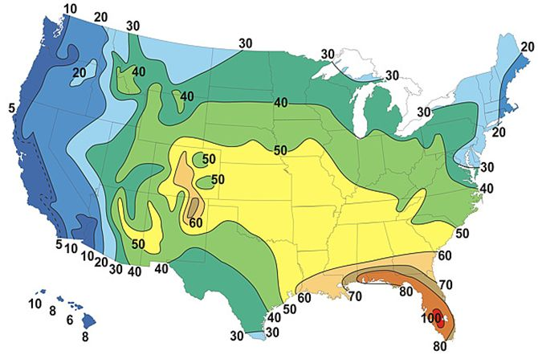
Thunderstorm Climatology
Annual Thunderstorm Days
Notes:
Here is a graphic of annual thunderstorm days based on climatology. Notice that the West Coast, including most of the ZSE air space, gets less than 20 thunderstorm days per year. The higher concentration of thunderstorms is primarily over the southeastern US coastal areas, plus near/just east of the Rockies in CO and northern NM.

Slide 4

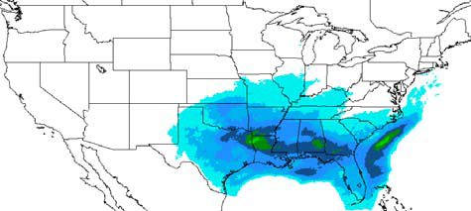
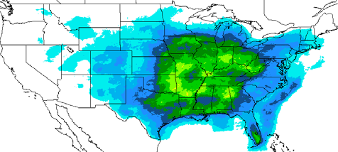
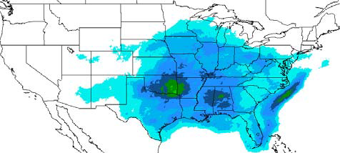
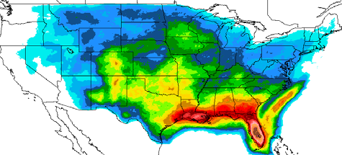
Convective SIGMET Climatology
March
May
April
June
Notes:
The climatology for Convective SIGMETs is similar to the thunderstorm days. The greater amount of thunderstorm activity is in the southeastern states near the coast, plus the relative max in parts of CO and NM. Activity increases in the spring.

Slide 5
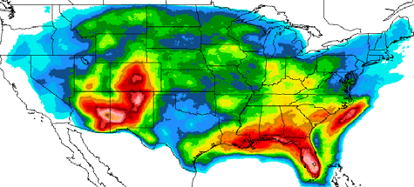
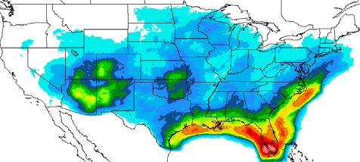
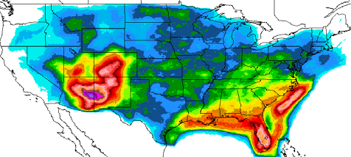
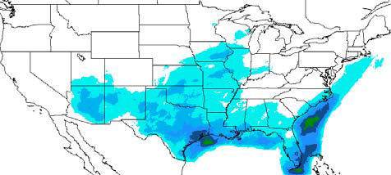
Convective SIGMET Climatology
July
September
August
October
Notes:
And then the activity continues to be strong into August, and begins to wane in September. We also have the relative maximum around the desert southwest during their monsoon season peak in July and August.

Slide 6
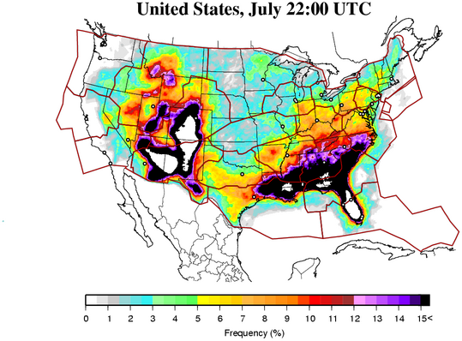
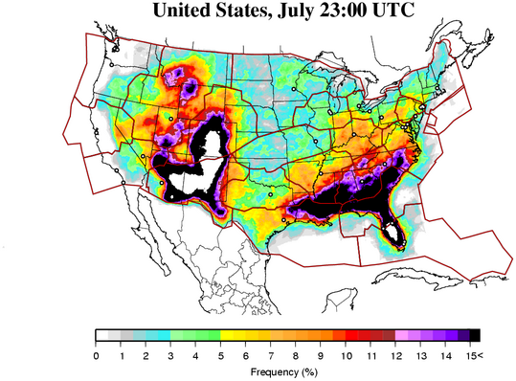
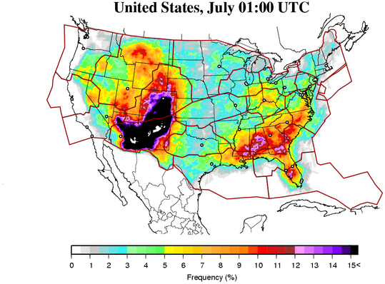
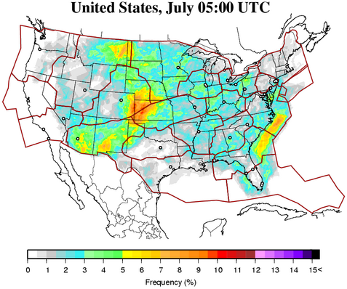
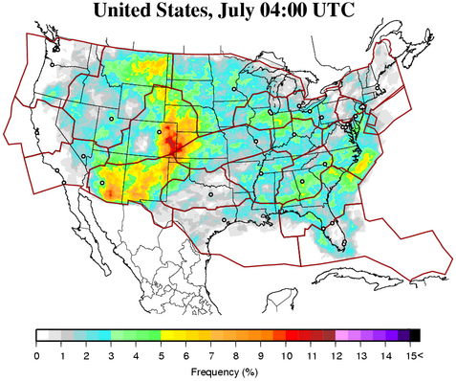
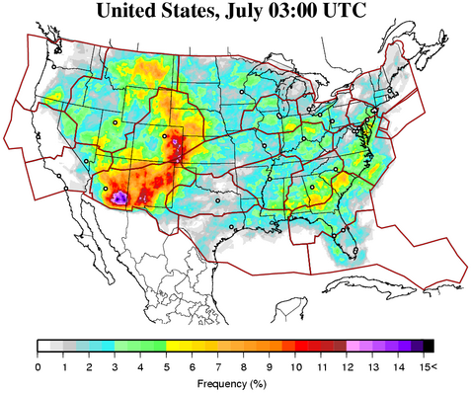
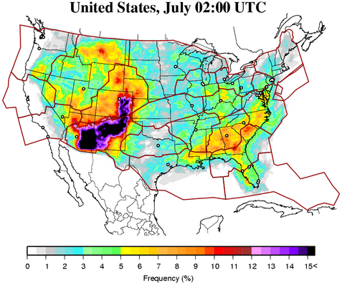
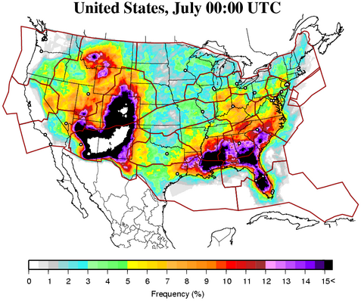
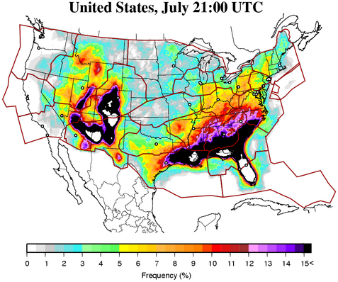
Convective SIGMET Climatology
Hourly Activity
Notes:
You can see the peak times for thunderstorm activity here in July at different times of day. Note that the convection peaks in the afternoon to early evening hours.

Slide 7
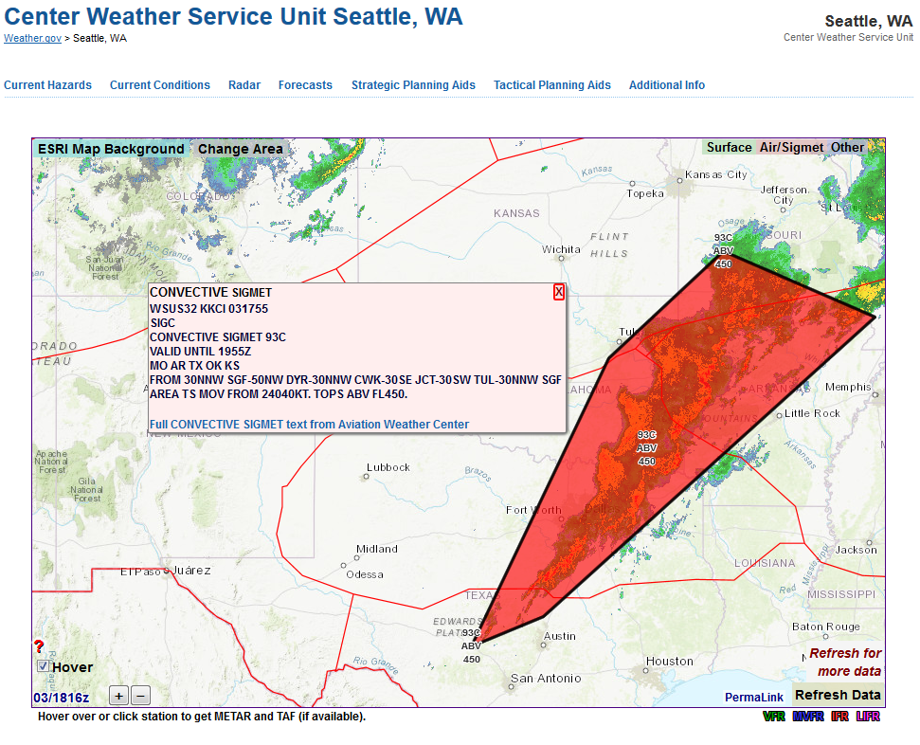
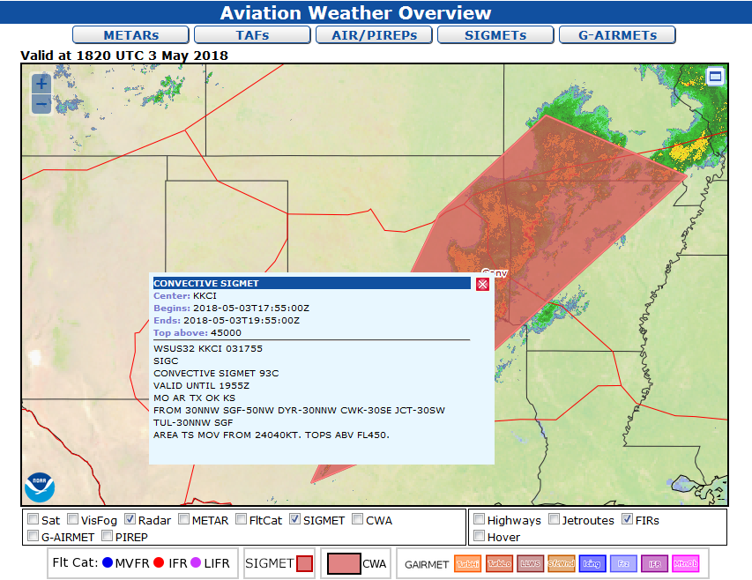
Convective SIGMET Displays
Seattle CWSU
https://www.weather.gov/zse
AWC (Aviation Weather Center)
https://www.aviationweather.gov/
Notes:
If you are at a computer, two pages to view Convective SIGMETs are shown here. The version on the left is our page, the Seattle CWSU home page. The other version on the right is available at the Aviation Weather Center, where the SIGMET is produced. These are displaying the same SIGMET with radar in the background. It is two different views of the same data.
PAUSE

Slide 8
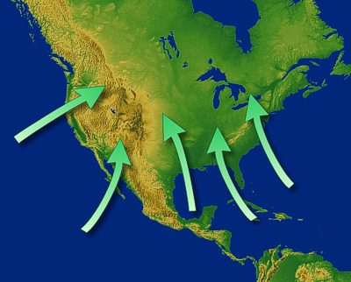
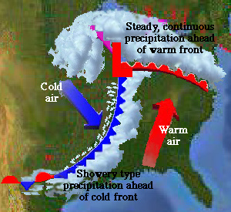
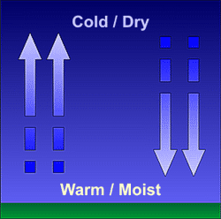
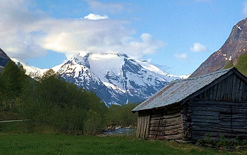
Thunderstorm Ingredients
Sources of Moisture
Instability
Sources of Lift
  Uneven heating
  Fronts, Drylines, Outflow Boundaries
  Terrain
Notes:
Thunderstorm Ingredients
Sources of Moisture
Instability
Sources of Lift
Uneven heating
Fronts, Drylines, Outflow Boundaries
Terrain

Slide 9
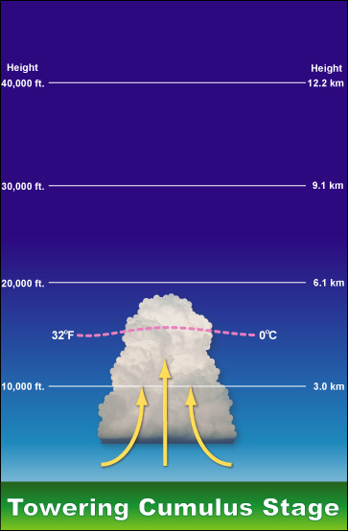
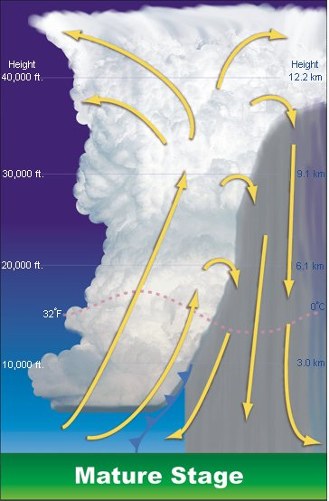
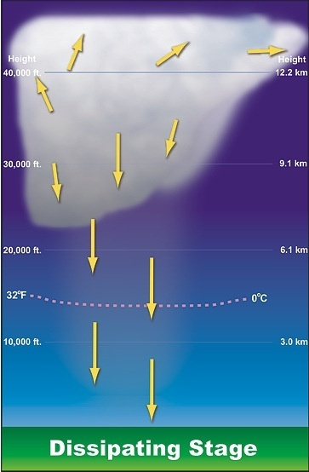
Thunderstorm Cell Life Cycle
3-5 mi
(5-8 km)
5-10 mi
(8-16 km)
5-7 mi
(8-11 km)
Notes:
As the thunderstorm develops, the towering cumulus will develop with the moisture rising, eventually getting above the freezing level.
Later the thunderstorm will reach the mature stage. Here there is inflow on the back side of the thunderstorm and heavy rain and down drafts on the forward side. As moisture rises, in hail can form in addition to the rain that has condensed.
The third stage here is the dissipating stage where it is mostly down drafts with weakening precip.

Slide 10
Single Cell Thunderstorm
3-5 mi
(5-8 km)
5-10 mi
(8-16 km)
5-7 mi
(8-11 km)
Notes:
The graphics above depict a single-cell thunderstorm.

Slide 11
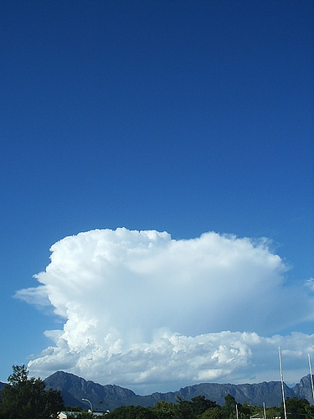
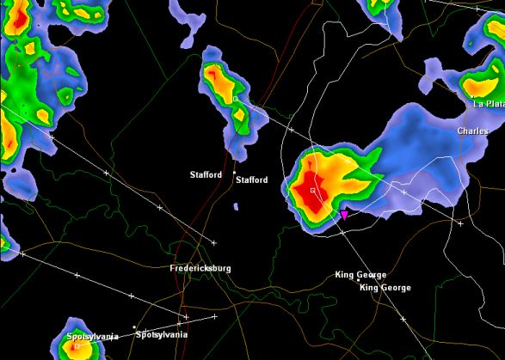
Single Cell
Also called “air mass thunderstorms”,
“ordinary thunderstorms”, or “garden variety thunderstorms.”
The lifting source is usually uneven surface heating. In the Pacific Northwest this often occurs over the mountains in the summer during late afternoon and evening hours.
These can pose a moderate to high danger for aviation but is usually easily circumnavigated visually by pilots
Life cycle typically 20-30 minutes
Notes:
Also called “air mass thunderstorms”,
“ordinary thunderstorms”, or “garden variety thunderstorms.”
The lifting source is usually uneven surface heating. In the Pacific Northwest this often occurs over the mountains in the summer during late afternoon and evening hours.
These can pose a moderate to high danger for aviation but is usually easily circumnavigated visually by pilots
Life cycle typically 20-30 minutes

Slide 12
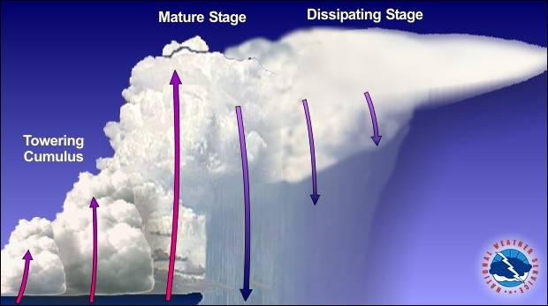
Multicell Cluster
Notes:
A multicell cluster of thunderstorms consists of a group of cells moving together, with each cell in a different portion of the life cycle. The newer/developing cells tend to form on the “upwind” side, generally the western or southwestern side, whereas the mature/dissipating cells are located on the “downwind” side, generally the eastern or northeastern side.

Slide 13
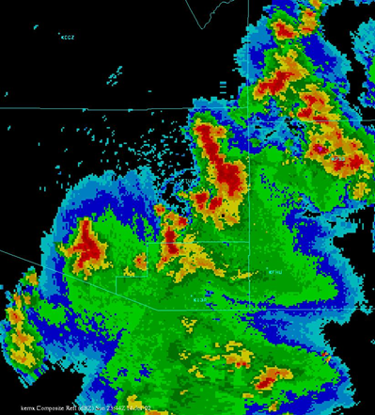
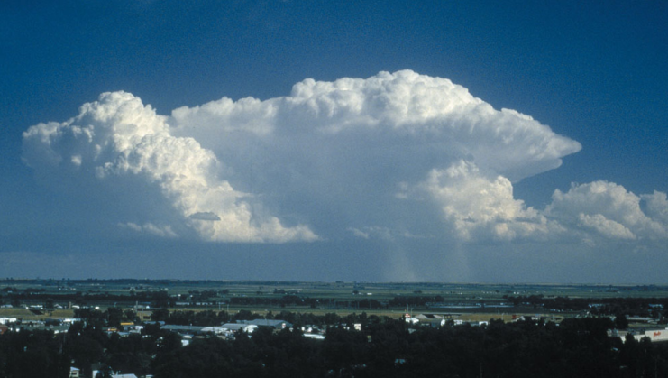
Multicell Thunderstorms
Group of thunderstorm cells
Move as a single unit
Each cell will be in a different stage of development
Pose moderate to high danger to aviation
Sometimes form as a line of storms (squall line) with a well developed gust front
Notes:
Multicell Thunderstorms
Group of thunderstorm cells
Move as a single unit
Each cell will be in a different stage of development
Pose moderate to high danger to aviation
Sometimes form as a line of storms (squall line) with a well developed gust front

Slide 14
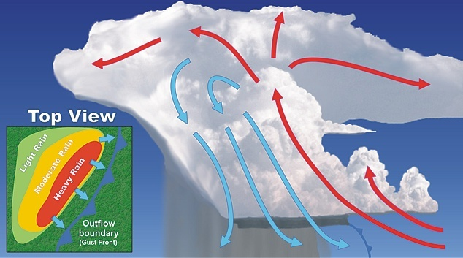
Multicell Line (Squall Line)
Notes:
A multicell (or squall) line consists of a line of storms with a continuous, well developed outflow boundary (or gust front) at the leading edge of the line. Downburst winds are a major threat of these storms.

Slide 15
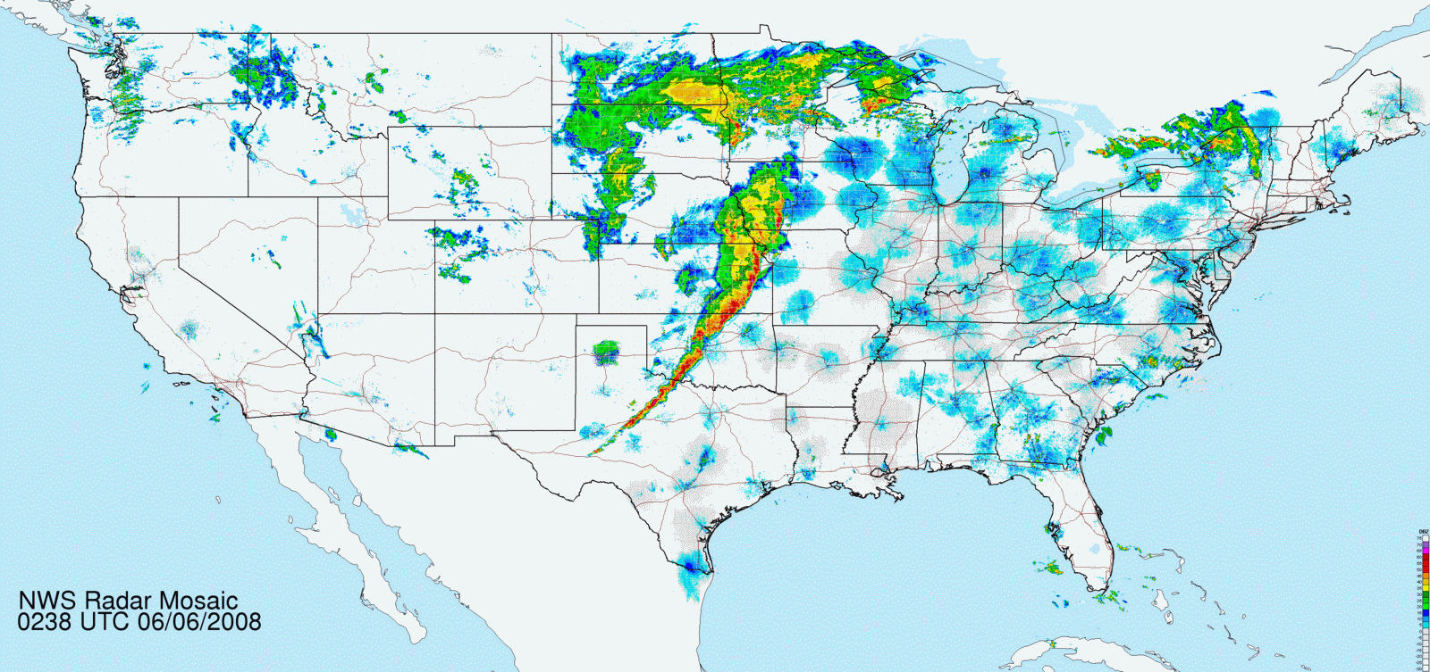
Multicell Squall Line
Notes:
Here is an example of a multicell squall line moving across the Plains from eastern KS to west-central TX.
PAUSE

Slide 16
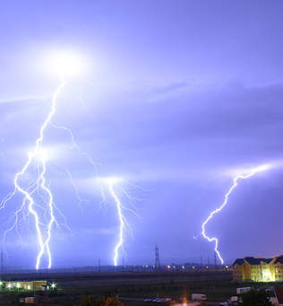
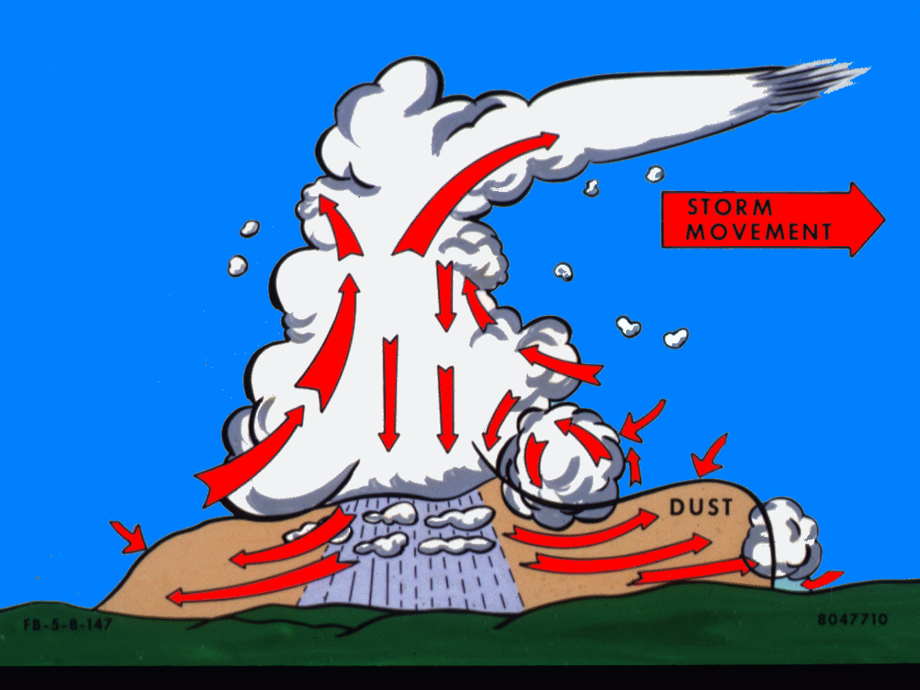
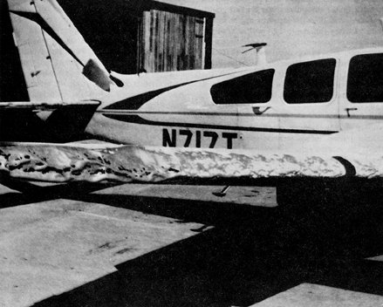
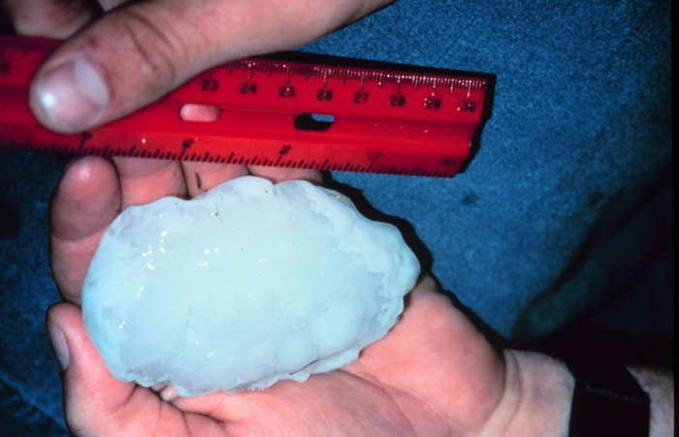
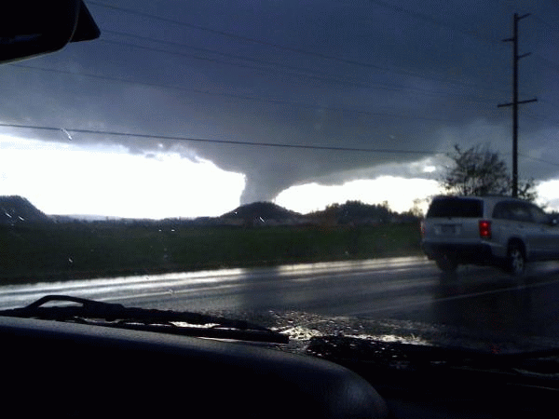
Thunderstorm Aviation Hazards
Turbulence
Icing
Wind Shear
  Gust Front
  Microbursts
Hail
Tornadoes
Lightning
Notes:
Thunderstorm Aviation Hazards
Turbulence
Icing
Wind Shear (Gust Front, Microbursts)
Hail
Tornadoes
Lightning

Slide 17
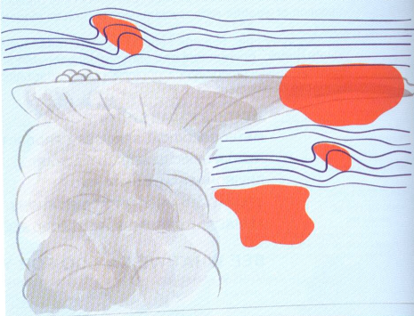
Thunderstorm Aviation Hazards
Convective Turbulence
FAA advises pilots to stay clear of TS by at least 20nm laterally
Known regions of turbulence around thunderstorms shaded in orange.
EDR-based turbulence measurements, combined with radar and satellite imagery have shown that the risk of severe turbulence is five times the background value at 10,000 ft above the cell and twice the background value at distances up to 40nm from the cell
CIT
CIT
CIT
CIT
Courtesy Wikipedia: WikiProject Aviation
CIT = Convectively Induced Turbulence
Notes:
 Convective Turbulence – Turbulent vertical motions that result from convective currents and the subsequent rising and sinking of air.
NOTE: Teach from slide.
Known regions of turbulence around thunderstorms shaded in orange.
EDR-based turbulence measurements, combined with radar and satellite imagery have shown that the risk of severe turbulence is five times the background value at 10,000 ft above the cell and twice the background value at distances up to 40nm from the cell
FAA advises pilots to stay clear of TS by at least 20nm laterally

Slide 18
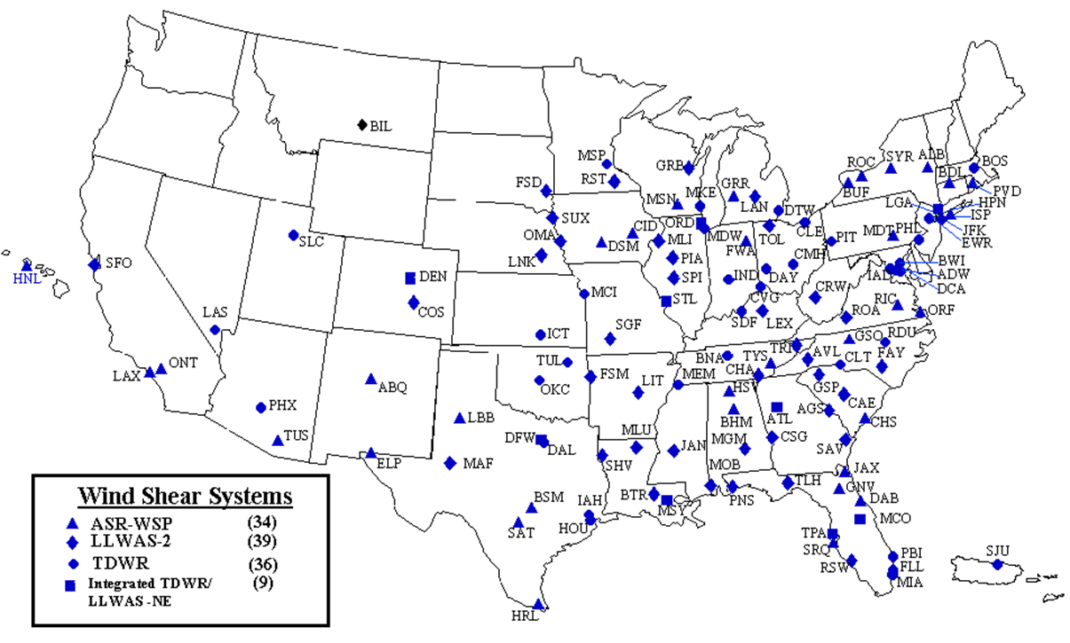
Thunderstorm Aviation Hazards
NAS Wind Shear Product Systems
Notes:
◉ The FAA has installed the following systems to warn terminal controllers and pilots of microbursts, wind shear, and gust fronts:
• Low-level wind shear alert system (LLWAS)
- Detects surface wind shear through the use of up to 32 remote wind sensors situated around an airport.
• Terminal Doppler weather radar (TDWR)
- Specialized weather radars used to detect microbursts, gust fronts, and convective storms along arrival and departure paths.
• Airport surveillance radar (ASR)-Weather system processor (WSP)
- An enhanced weather processor for the ASR-9 air traffic control radar that includes Doppler wind estimation for the detection of low-level wind shear.
◉ Tower controllers relay specific alerts from these systems to pilots via voice radio communication.

Slide 19
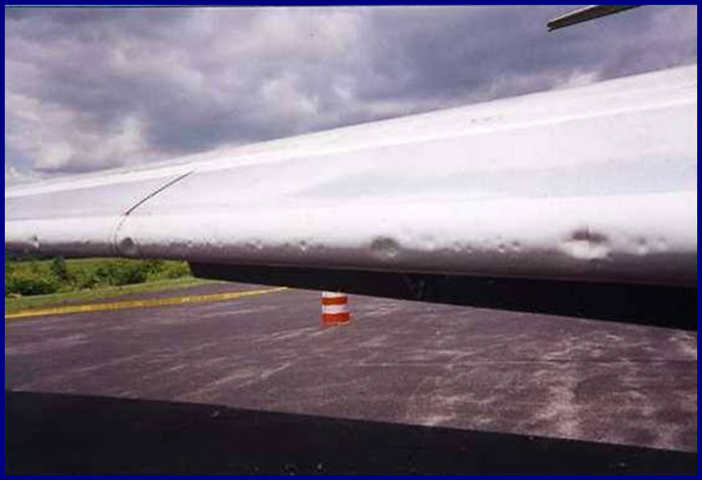
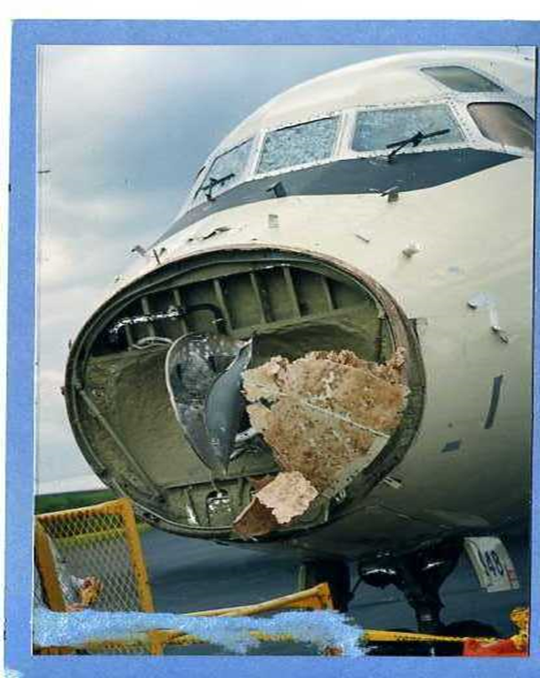
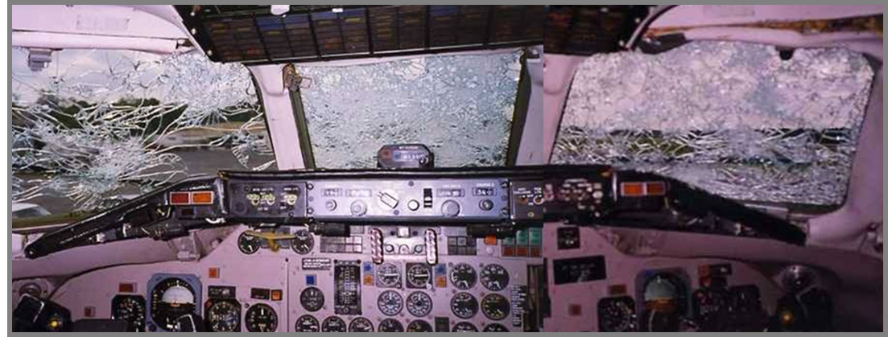
Thunderstorm Aviation Hazards
Hail Damage
Notes:
Pictures of shattered windshield, dents in leading edge of wing, and destruction of aircraft radome.
PAUSE

Slide 20
Thunderstorm Advisories
Convective SIGMETS
  Issued by the Aviation Weather Center
  Issued at 55 min past the hour as a collective, valid for 2 hours
  Area (3,000 square miles) with 40% coverage of very strong radar returns or significant satellite or lightning strike signature
  Line of TS 60nm long with 40% coverage
  TS embedded in multiple cloud layers
  Severe TS with winds > 50kts, hail ≥ 1”, tornadoes
  Each issuance supersedes the previous hour
Center Weather Advisories
  Issued by CWSUs
  Valid for up to 2 hours
  Issued when area too small or TS not strong enough for a convective SIGMET
Severe Thunderstorm or Tornado Watch
  Aviation portion of the watch resent as an MIS
Notes:
NOTE: Teach from slide.
Thunderstorm Advisories
Convective SIGMETS
Issued by the Aviation Weather Center
Issued at 55 min past the hour as a collective, valid for 2 hours
Area (3,000 square miles) with 40% coverage of very strong radar returns or significant satellite or lightning strike signature
Line of TS 60nm long with 40% coverage
TS embedded in multiple cloud layers
Severe TS with winds > 50kts, hail ≥ 1”, tornadoes
Each issuance supersedes the previous hour
Center Weather Advisories
Issued by CWSUs
Valid for up to 2 hours
Issued when area too small or TS not strong enough for a convective SIGMET
Severe Thunderstorm or Tornado Watch
Aviation portion of the watch resent as an MIS

Slide 21
Thunderstorm Advisories
Thunderstorm tops in advisories are precipitation tops not cloud tops
Pilots often report cloud tops…not precipitation tops!
Cloud tops are normally 2-10 thousand feet higher than precipitation tops
Notes:
Thunderstorm tops in advisories are precipitation tops not cloud tops
Pilots often report cloud tops…not precipitation tops!
Cloud tops are normally 2-10 thousand feet higher than precipitation tops

Slide 22
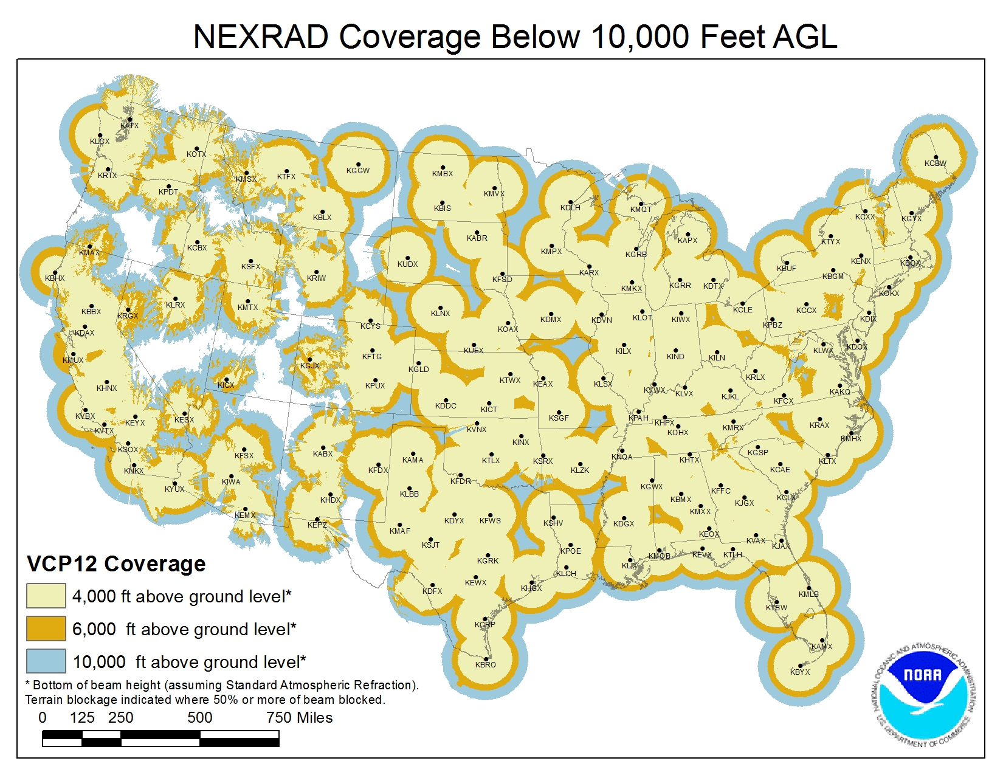
Radar Coverage
Notes:
Here is the NWS NEXRAD coverage below 10,000ft AGL across the contiguous US. Note that from the Plains eastward the coverage generally is very good, but gets more spotty near/west of the Rockies. For ZSE the coverage is particularly sparse over parts of central/southeastern OR into northwestern NV. This is due to a combination of terrain blocking the radar beams and fewer NEXRAD radar sites out west. In areas of sparse coverage, meteorologists will rely more heavily on satellite signatures and lightning data.
PAUSE

Slide 23
TCF
Traffic Flow Management (TFM) Convective Forecast (TCF)
  The TCF is a high confidence graphical representation of forecasted convection meeting specific criteria of coverage, intensity, and echo top height.
  The TCF graphics are produced every 2 hours and valid at 4-, 6-, and 8- hours after issuance time.
  The TCF domain is the Flight Information Regions (FIR) covering the 48 contiguous states and adjacent coastal waters. It also includes the Canadian airspace south of a line from Thunder Bay, Ontario to Quebec City, Quebec.
Audience/Users
  The TCF is used by air traffic management decision-makers in support of convective weather mitigation strategies within the NAS. It is designed to meet the needs of TFM decision makers at the Federal Aviation Administration’s (FAA) Air Traffic Control System Command Center (ATCSCC), FAA Air Route Traffic Control Center (ARTCC) Traffic Management Units (TMU), and airline and corporate Flight Operations Centers (FOC).
Notes:
NOTE: Teach from slide.
TCF
Traffic Flow Management (TFM) Convective Forecast (TCF)
The TCF is a high confidence graphical representation of forecasted convection meeting specific criteria of coverage, intensity, and echo top height.
The TCF graphics are produced every 2 hours and valid at 4-, 6-, and 8- hours after issuance time.
The TCF domain is the Flight Information Regions (FIR) covering the 48 contiguous states and adjacent coastal waters. It also includes the Canadian airspace south of a line from Thunder Bay, Ontario to Quebec City, Quebec.
Audience/Users
The TCF is used by air traffic management decision-makers in support of convective weather mitigation strategies within the NAS. It is designed to meet the needs of TFM decision makers at the Federal Aviation Administration’s (FAA) Air Traffic Control System Command Center (ATCSCC), FAA Air Route Traffic Control Center (ARTCC) Traffic Management Units (TMU), and airline and corporate Flight Operations Centers (FOC).

Slide 24
TCF
Collaborative
  Aviation meteorologists from AWC, FAA Command Center, CWSUs, airlines, and Environment Canada participate.
Area Criteria
  Composite radar reflectivity of at least 40 dBZ
  Echo tops at or above FL250
  Coverage (above criteria) of at least 25% of the polygon area
  Forecaster confidence of at least 50% (High) that above criteria will be met.
Line Criteria
  Composite radar reflectivity of at least 40 dBZ having a length of at least 100 nautical miles (NM)
  Having a linear coverage of 75% or greater
  Having echo tops at or above FL250
  Forecaster confidence of at least 50% (High) that above criteria will be met.
Notes:
NOTE: Teach from slide.
TCF
Collaborative
Aviation meteorologists from AWC, FAA Command Center, CWSUs, airlines, and Environment Canada participate.
Area Criteria
Composite radar reflectivity of at least 40 dBZ
Echo tops at or above FL250
Coverage (above criteria) of at least 25% of the polygon area
Forecaster confidence of at least 50% (High) that above criteria will be met.
Line Criteria
Composite radar reflectivity of at least 40 dBZ having a length of at least 100 nautical miles (NM)
Having a linear coverage of 75% or greater
Having echo tops at or above FL250
Forecaster confidence of at least 50% (High) that above criteria will be met.

Slide 25
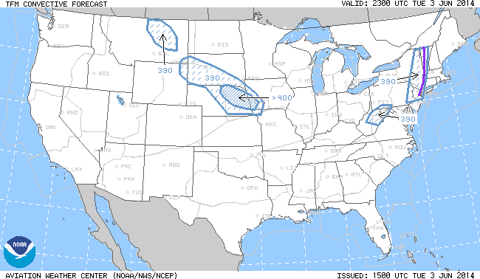
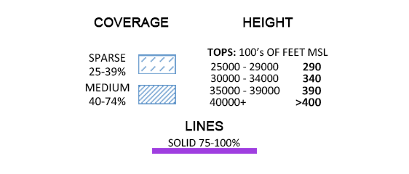
TCF
Notes:
Here is a graphic depiction of the final product. Note the purple line around New England and New York for the line of thunderstorms, and then the different shaded areas for coverage amounts (greater around eastern NE). Tops also are indicated with the graphics.
PAUSE

Slide 26
Seattle CWSU Convection Page
Notes:
Another resource for convection is at the Seattle CWSU’s Convection Page. Some products that are displayed in addition to the TCF include SPC activity, Pacific NW radar, convective SIGMETs. We also would recommend exploring the various items in the drop-down menus above for more weather-related resources.

Slide 27

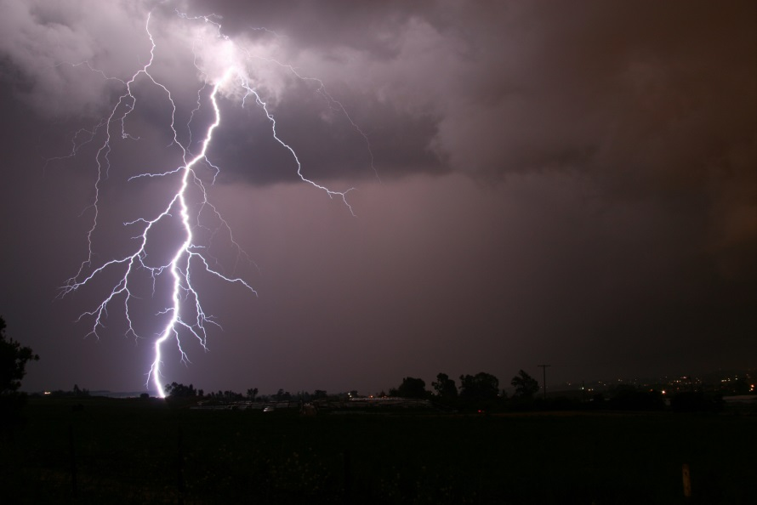
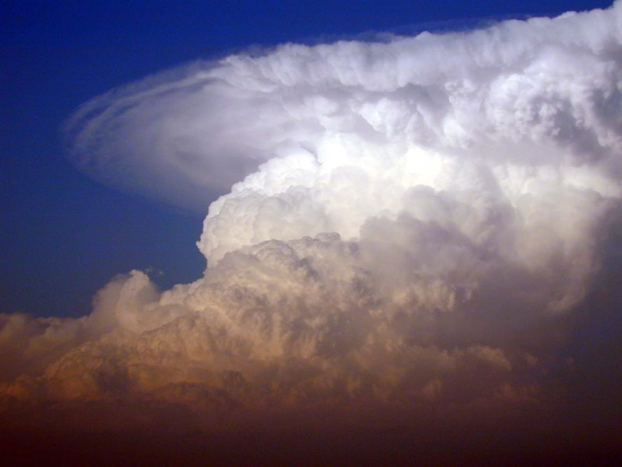
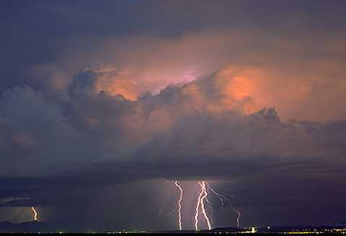
The end
James.Vasilj@noaa.gov
Seattle CWSU
Notes:
Thank you for watching this presentation. Please feel free to contact the Seattle CWSU with any questions that you have about thunderstorm activity, or with any other weather-related questions.

Slide 28
Thunderstorm Advisories
Thunderstorm tops in advisories are precipitation tops (18dBz) not cloud tops
Pilots often report cloud tops…not precipitation tops!
Cloud tops are normally 2-10 thousand feet higher than precipitation tops

