Slide 1

Danny Mercer
Forecaster, National weather Service
Seattle
2018 NW Aviation
Conference & Trade Show

Slide 2
Agenda
Aviation Operations:
  Weather Forecast Office, Seattle
  Center Weather Service Unit, Seattle area
  Aviation Weather Center, Kansas City
Area & Aviation Forecast Discussions
Identifying Types of Weather Charts
Interpreting Constant Pressure Charts
Satellite Interpretation Relative to Charts

Slide 3
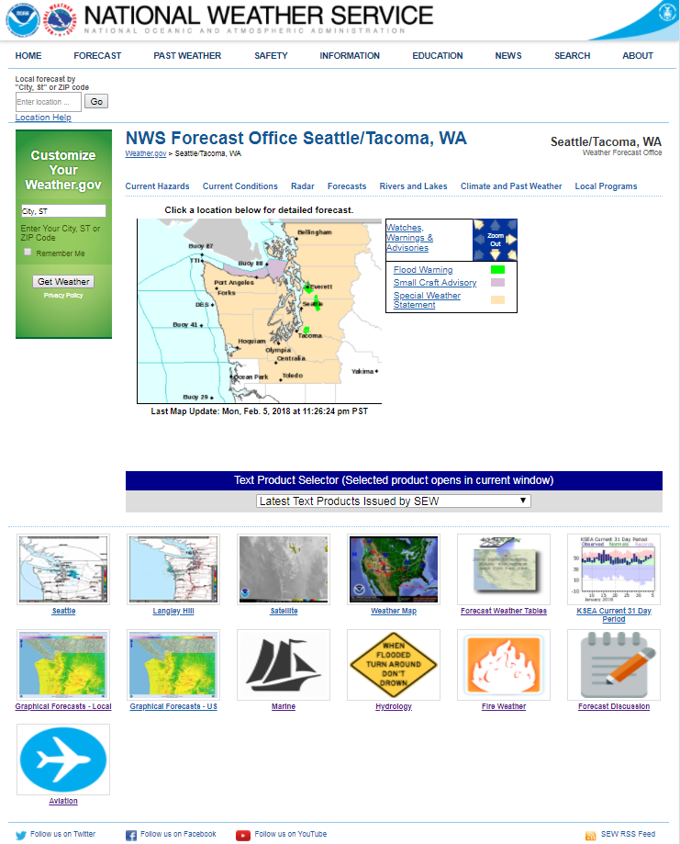
www.weather.gov/seattle
Point & Click
Forecast
AFD
Aviation Page Icon

Slide 4
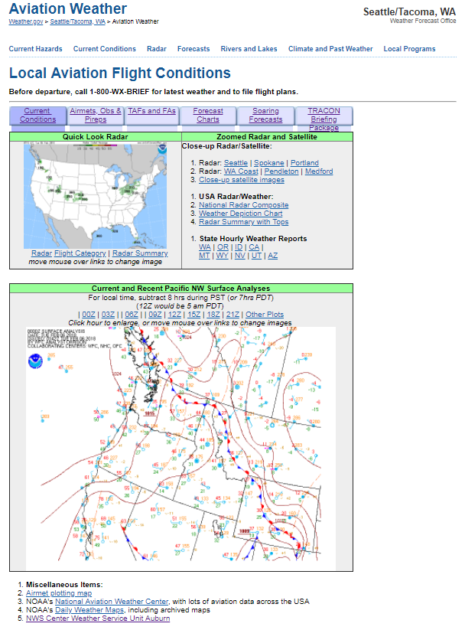
Seattle Weather Office Aviation Page
TAF Sites:
Sea-Tac
(SEA)
Boeing F.
(BFI)
Paine F.
(PAE)
Bellingham
(BLI)
Olympia
(OLM)
Bremerton
(PWT)
Port Angeles
(CLM)
Hoquiam
(HQM)
Produce Terminal Aerodome Forecasts (TAFs) 4 times daily.
TAFs are routinely amended to address changing weather conditions.
Coded forecast includes wind speed/direction, visibility, cigs, weather (rain/snow)

Slide 5
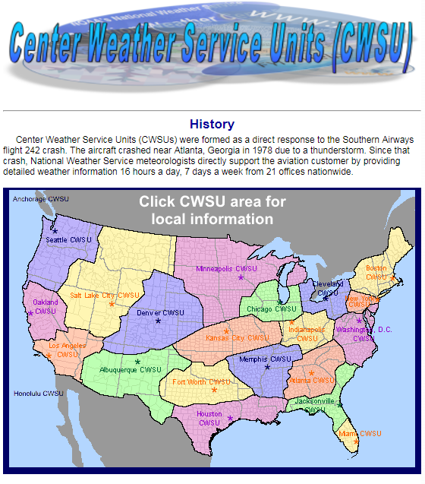
Center Weather Service Unit (CWSU)
Provide weather support and briefings to FAA managers and controllers.
Rerouting of aircraft are largely based on CWSU forecasts.
Issue Center Weather Advisories (CWA), describing near term weather hazards valid up to 2 hours.
Issues Meteorological Impact Statements (MIS), describing weather impacts on air traffic operations valid up to 12 hours.

Slide 6
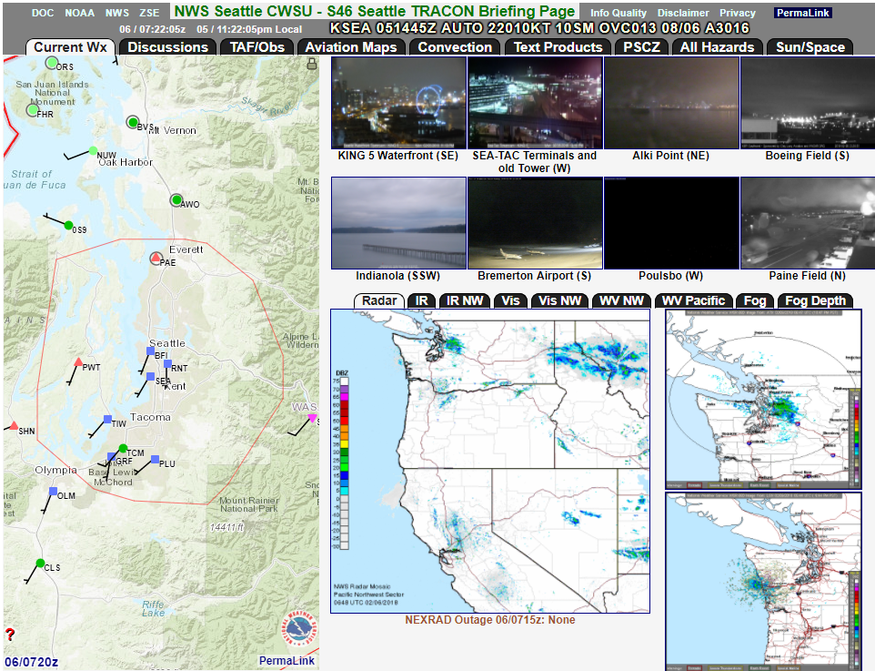
ZSE CWSU
TRACON Briefing Pages
www.weather.gov/zse

Slide 7
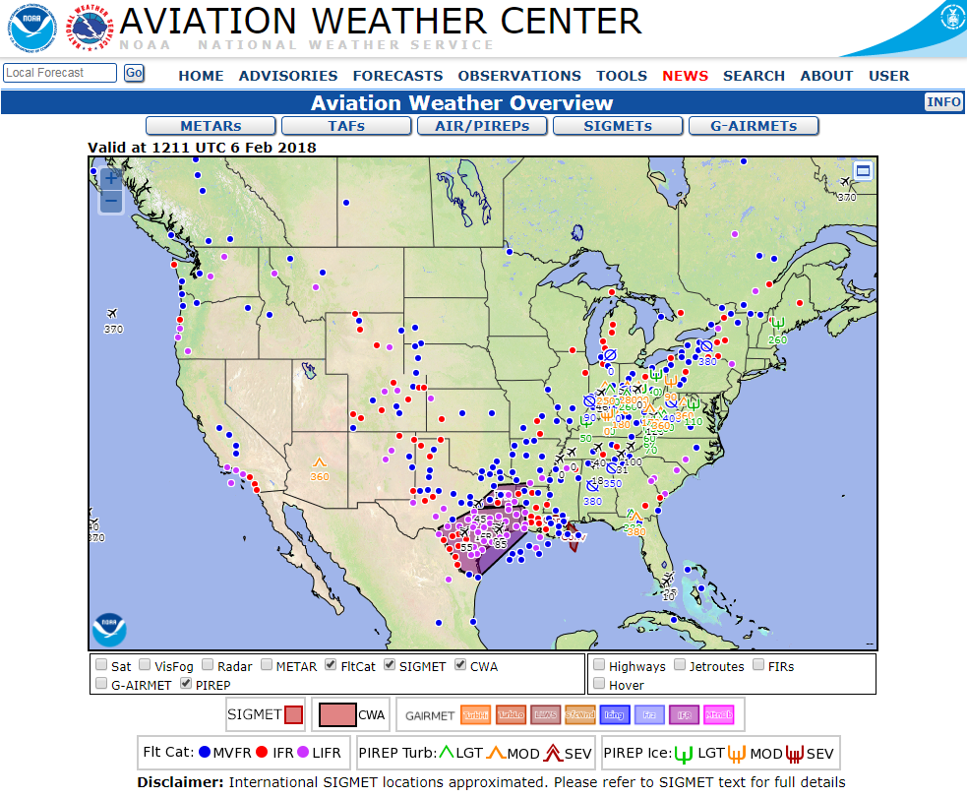
Aviation Weather Center (AWC)
Aviationweather.gov
Provides ADDS data and charts for an array for aviation weather related hazards at a national level.
Issue SIGMETS & G-AIRMETS
Briefing support and much more current and forecast information available!

Slide 8
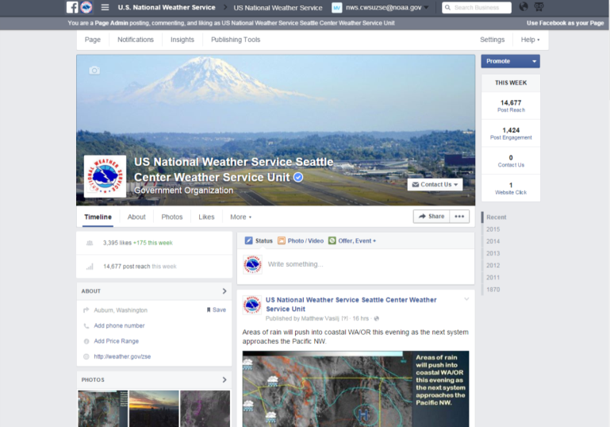
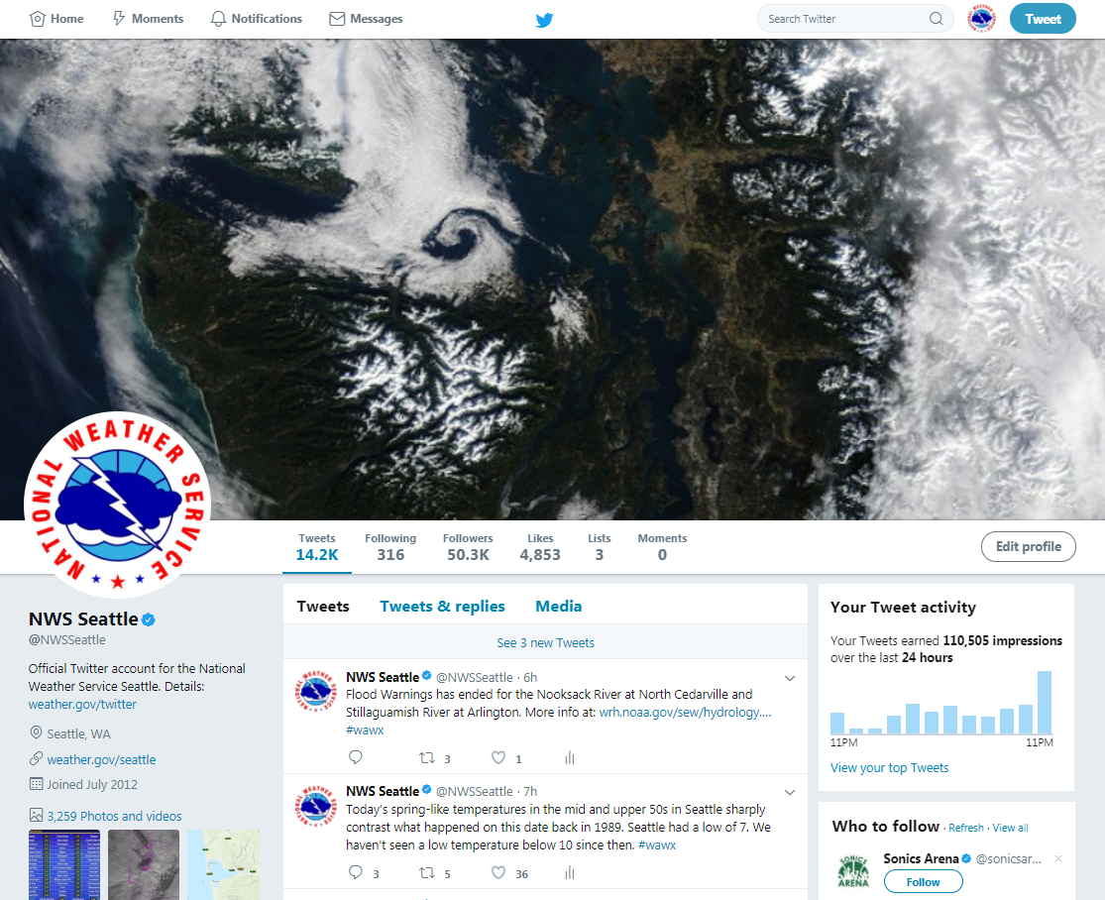
Social Media Activities
CWSU & NWS Seattle
Both active on Facebook & Twitter

Slide 9
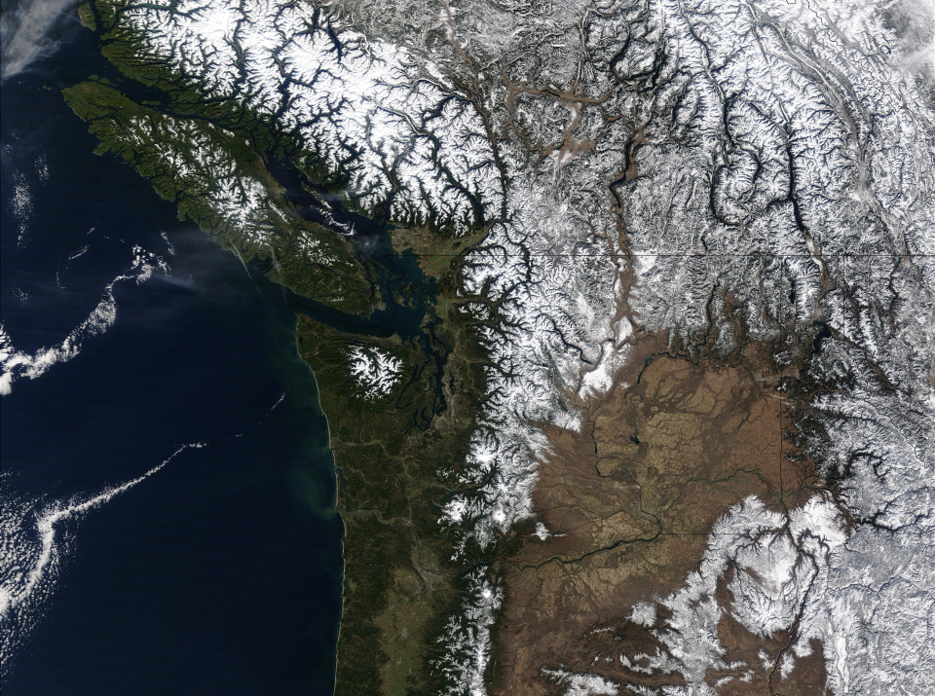
Interpreting Weather Charts
On The Internet
Slides Created By:
Michael Petrucelli
Meteorologist
Medford Weather Forecast Office

Slide 10
Introduction
“How Can You
Learn More About the Weather?”
Area Forecast Discussions (AFD’s)
Identifying Types of Weather Charts
Interpreting Constant Pressure Charts
Satellite Interpretation Relative to Charts

Slide 11
“How Can You
Learn More About the Weather?”
Online Courses
  Weather Theory for Pilots
  COMET Program by MetEd
  Embry-Riddle (and others)
Resident and Non-Resident Degrees
  BS – Aviation Meteorology (FIT)
  BS – Atmospheric Sciences or Meteorology (UW & other schools nationally)

Slide 12
“How Can You
Learn More About the Weather?”
A no-cost option for YOU to do it (thought it will take time and patience) is the…
Area & Aviation Forecast Discussions (AFD’s)
Discusses the current weather and forecast
NWS meteorologist’s view of the weather
Issued 4 times daily by the Seattle Weather Office
Issued twice daily by CWSU Seattle/Auburn

Slide 13
“How Can You
Learn More About the Weather?”
This is and iterative process…
Read and digest the AFD
Compare this to widely available data
  Forecast Charts
  Satellite Imagery
  Radar Imagery
Repeat daily until it’s second nature

Slide 14
Area Forecast Discussion
Read and digest the most current AFD’s
“But where do I find the AFD’s?”
  Central Weather Service Unit (CWSU), Seattle Website
  CWSU issued 2 times daily, wider regional focus www.weather.gov/ZSE
  Weather Forecast Office (WFO), Seattle Website
  WFO issued 4 times daily, covers most of Wrn WA
  Also accessible from the CWSU page above!
  www.weather.gov/Seattle (Aviation icon link at bottom)

Slide 15

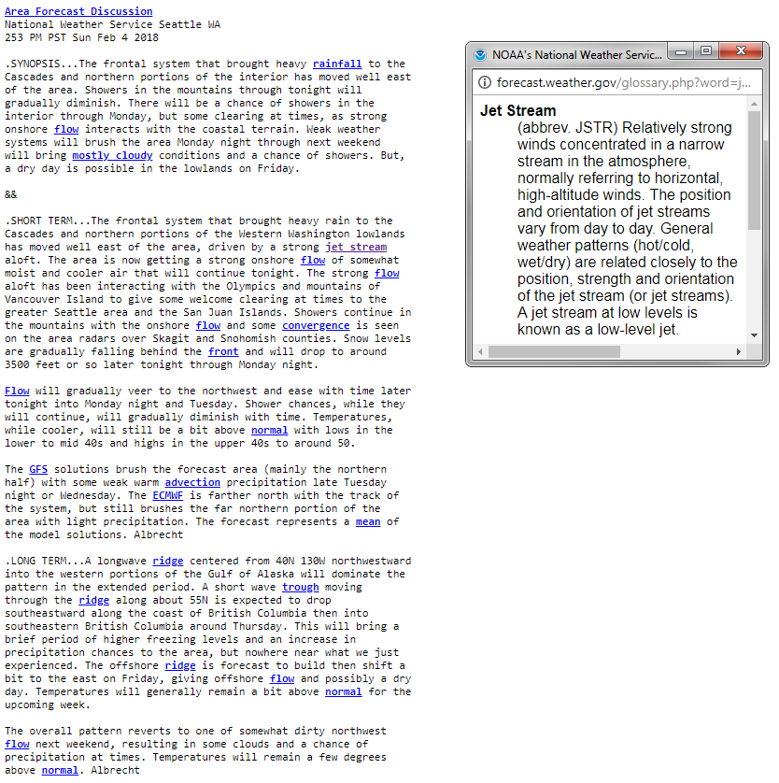
Hover or clicking on, highlighted weather terms opens up a plain text definition.

Slide 16
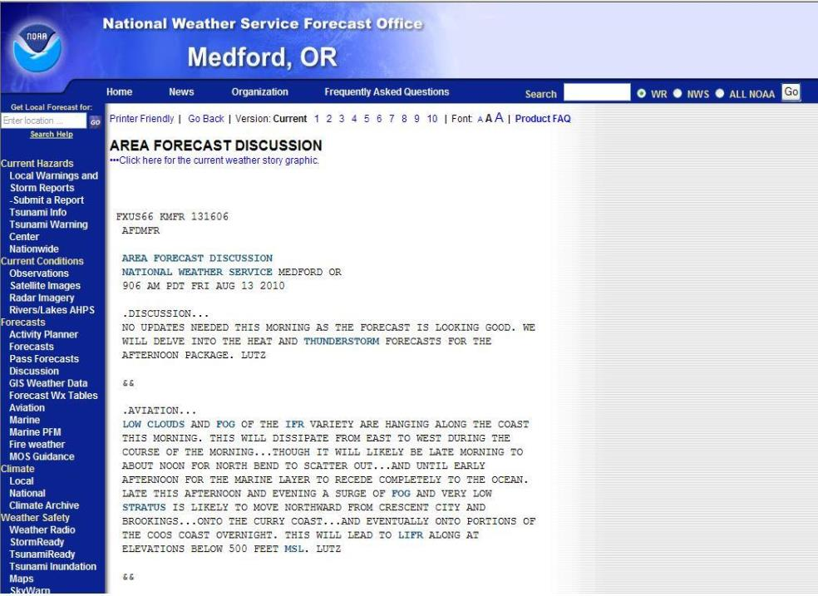
National Weather Service Forecast Office
Sample Aviation Discussion

Slide 17
Aviation Weather Discussion
Aviation Section of the AFD
  Follows the long term forecast discussion
  Communicates uncertainty of conditions
  Explains influence of local effects
  Emphasizes high-impact conditions/events

Slide 18
Interpreting Weather Graphics
Step 2: Analyze weather data on the internet
Compare the AFD to information online
  Weather Forecast Charts
  Weather Analysis Charts
  Satellite Imagery
  Radar Imagery

Slide 19
Interpreting Weather Graphics
Aviation Maps
  AIRMETs, SIGMETs, Freezing Level, Etc.
  Surface Analysis and Sensible Weather
  Flight Level Winds and Profiles
Meteorological Forecast Charts
  Upper Level (i.e., Constant Pressure/Height)
  Used by Meteorologists to Make Forecasts

Slide 20
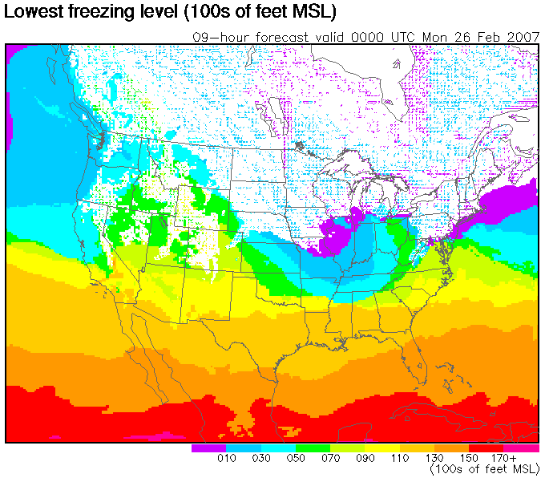
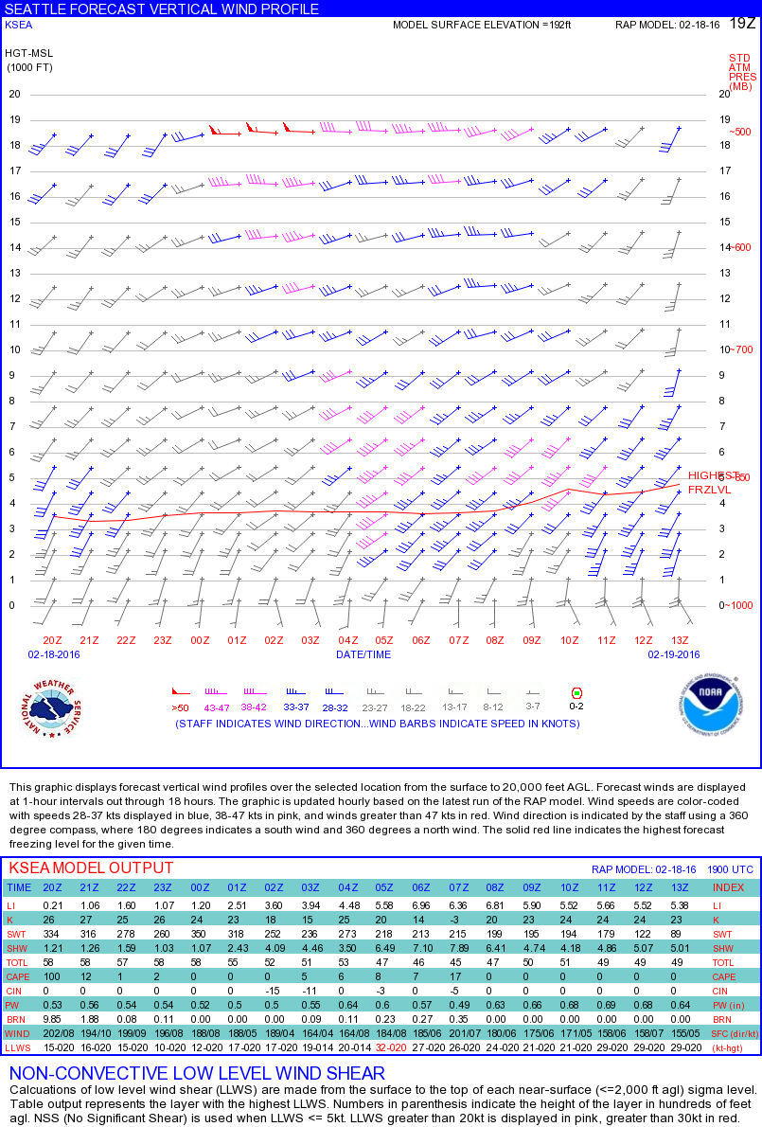
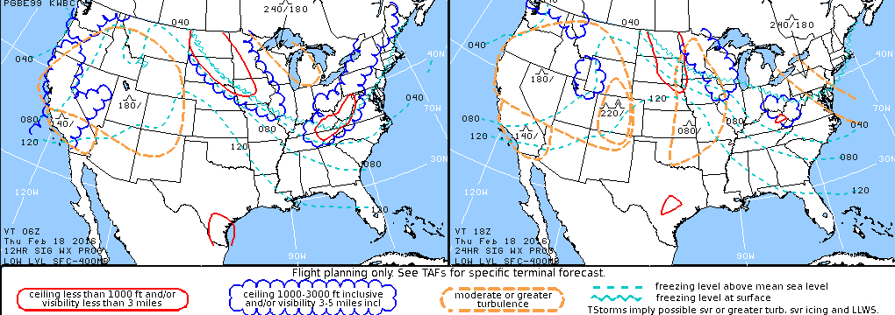
Interpreting Weather Graphics

Slide 21
Interpreting Forecast Charts
Here’s a quick and simple tutorial for interpreting constant pressure charts.
The contours are lines of constant height, so look at these charts like a topographical map.
Knowing this will help you answer the question,
“What is an upper level shortwave trough?”

Slide 22
Interpreting Forecast Charts
Rotate
and
View
From
Above
Surface
Lines of Equal Height Around Mountain
Get Rid of the Land
Connect Points of Equal Height
Think about a mountain…

Slide 23
Interpreting Forecast Charts
Looking Down on High Pressure

Slide 24
Interpreting Forecast Charts
Rotate
and
View
From
Above
Ridge
Ridge
High
Center
Peak
Not all Pressure Centers are Concentric
Not all Pressure Centers are Concentric
Not all Mountains are Concentric

Slide 25
Interpreting Forecast Charts
High
Center
Ridge
Looking Down on a Ridge and High Pressure

Slide 26
Interpreting Forecast Charts
Rotate
and
View
From
Above
Lines of Equal Height Around Valley
Now, Let’s Think of a Valley…
Connect Lines of Equal Depth
Remove the Terrain

Slide 27
Interpreting Forecast Charts
Looking Down on Low Pressure

Slide 28
Interpreting Forecast Charts
Rotate
and
View
From
Above
Trough
Trough
Low
Valley
Not all Pressure Centers are Concentric
Not all Valleys are Concentric
Not all Pressure Centers are Concentric

Slide 29
Interpreting Forecast Charts
Low
Center
Trough
Looking Down on a Trough and Low Pressure

Slide 30
Interpreting Forecast Charts
So to recap…
A ridge is like an elongated mountain on a constant pressure chart, and is associated with high pressure.
A trough would be the same as an elongated valley, and is associated with low pressure.

Slide 31
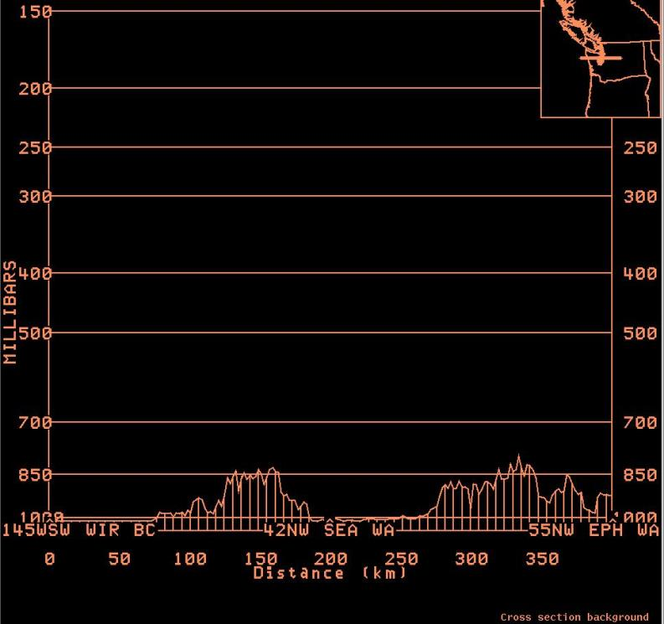
Standard Pressure Levels
200 mb ~ 39,000 ft
300 mb ~ 30,000 ft
500 mb ~ 18,000 ft
700 mb ~ 10,000 ft
850 mb ~ 5000 ft

Slide 32
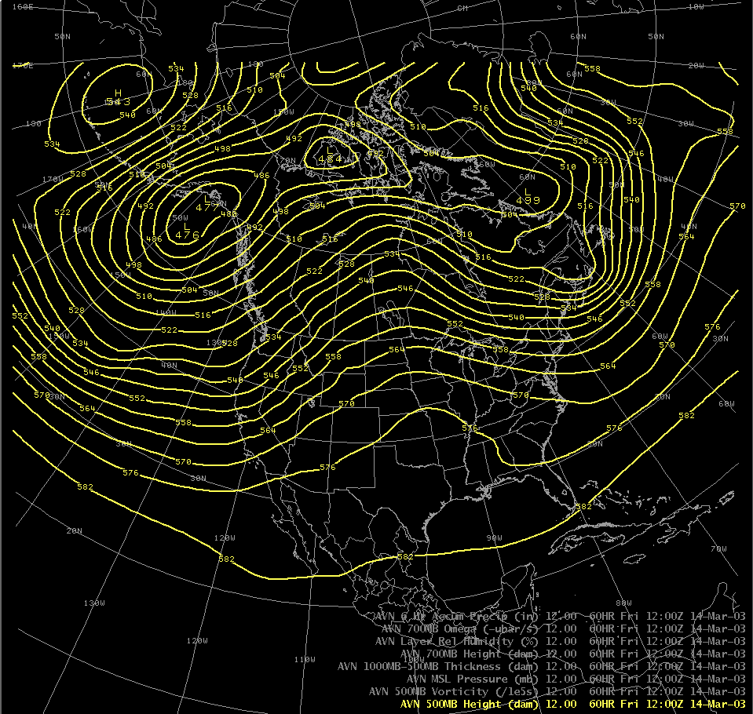
This is a Ridge
This is a 500 Millibar constant pressure chart
500 mb is around 18,000 feet
and is about the middle of the atmosphere (in terms of pressure).
This is a Trough

Slide 33
If you were to travel this line, you would be going uphill first, then downhill.

Slide 35
Interpreting Forecast Charts
The vertical distance between the
lowest height (4760 meters) and the
highest height (5820 meters) on this chart
is ONLY 1060 meters (or 3478 feet).
That’s about the size of a small hill…
But in the case of our weather,
it makes a BIG difference!

Slide 36
Interpreting Forecast Charts
In general, higher pressure produces better weather than lower pressure.
Ridges = Good weather, lack of clouds
Downward motion in the atmosphere Associated with surface highs/ridges
Troughs = Poor weather, clouds/precipitation
Upward motion in the atmosphere Associated with surface lows/troughs

Slide 37
Interpreting Forecast Charts
There are ridges and troughs with larger temporal and spatial scales…
We call these long waves
And there are ridges and troughs with smaller scales…
We call these short waves

Slide 38
Interpreting Forecast Charts
A very important point to remember…
Small, upper level short wave troughs help to drive surface frontal systems!

Slide 39
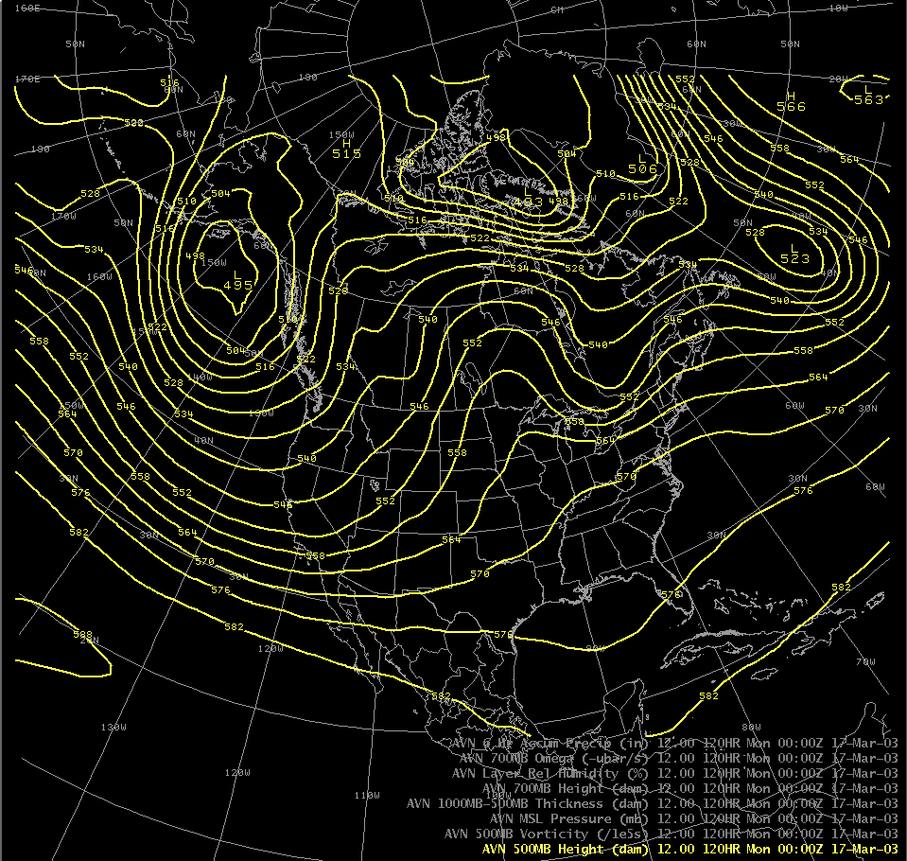
This is a big long wave trough
This is a small short wave trough

Slide 40


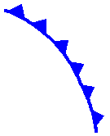
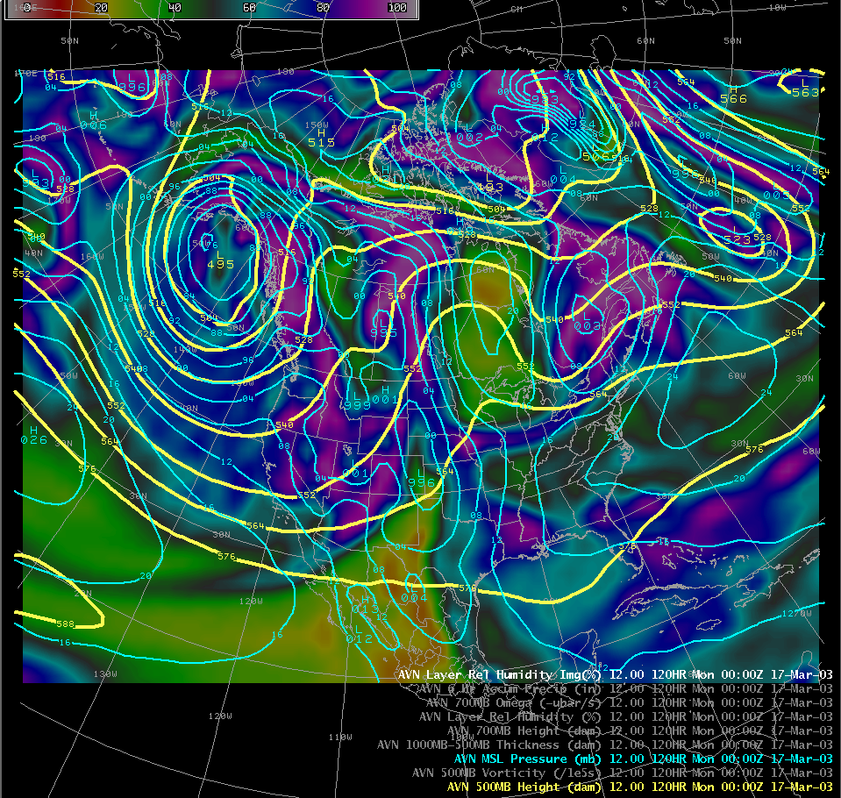
Here’s the surface low
and frontal system
And the upper level
short wave trough

Slide 41
Interpreting Forecast Charts
Here’s something else to consider…
Large, long wave ridges and troughs are defined by how the jet stream (or storm track) flows around the entire hemisphere.
Small, short waves are embedded within this flow, and move along, up, and over long wave ridges, and down (and around) long wave troughs!

Slide 42
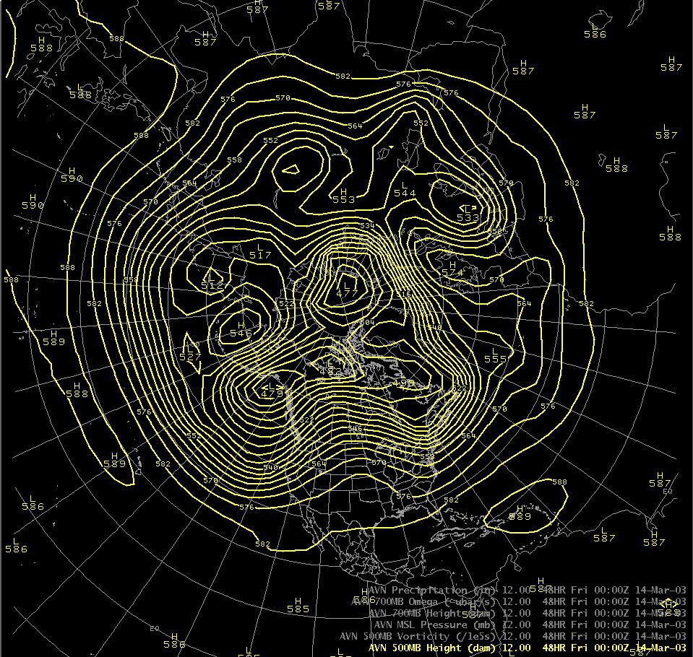
Here’s how the jet stream flows…
Short Wave Ridges
Short Wave Troughs
Long Wave Troughs
Long Wave Ridge

Slide 43
Interpreting Forecast Charts
So, to recap…
1) Upper level ridges ~ good weather
Upper level troughs ~ bad weather
2) Large ridges/troughs (long waves)
Small ridges/troughs (short waves)
Upper level short wave troughs are associated with
surface frontal systems
4) Short wave troughs move along in the “storm-track”
defined by long-waves around the hemisphere.

Slide 44
Interpreting Forecast Charts
A couple more points…
Winds blow from highs to lows, typically parallel to lines of constant height (700 mb and above)
The strength of the wind is proportional to the distance between the lines (i.e., the gradient)
  Strong winds = lines close together
  Weaker winds = lines further apart

Slide 45
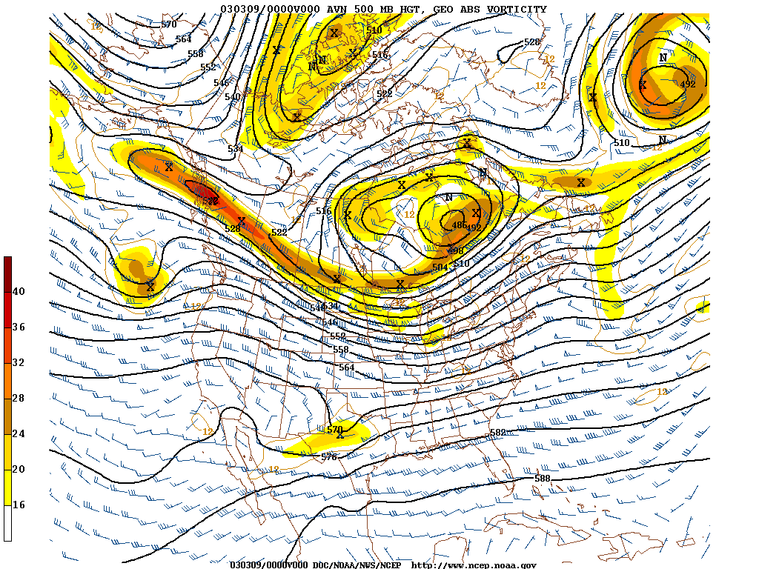
Area where winds
are strong
Area where
winds are
weak

Slide 46

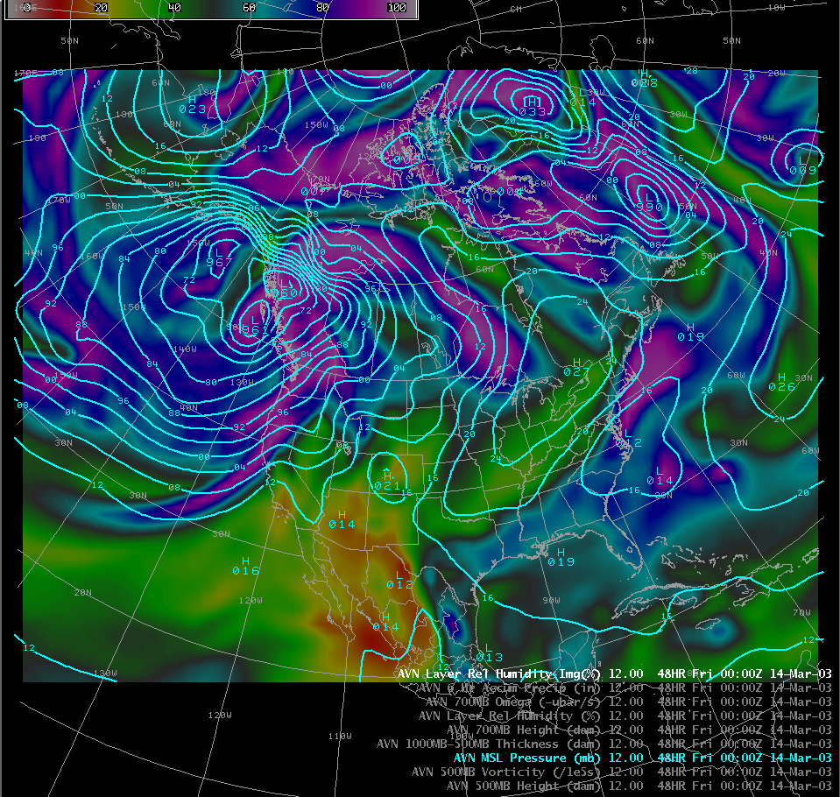
Winds will be stronger
here
Winds will be weaker
here
This is a surface pressure chart
It shows areas of high and low pressure

Slide 47
Interpreting Satellite Imagery
Types of Imagery
Visible – Image of clouds visible to the human eye (as if you were on the satellite)
  Typically black and white (not color enhanced)
Infrared – Image of cloud top temperature
  Colder clouds show up brighter/whiter
  Color enhancements are often used

Slide 48
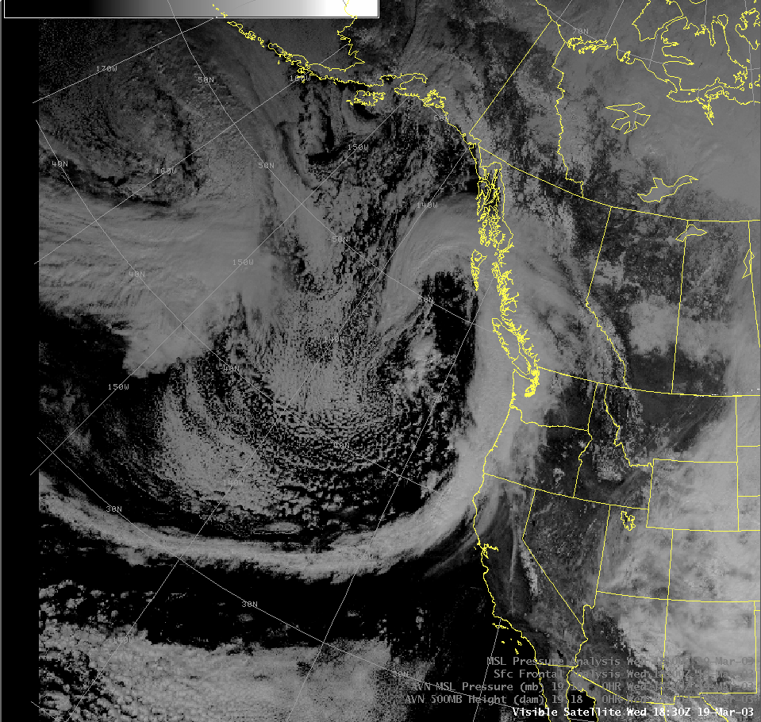
Example: Visible Satellite Imagery

Slide 49
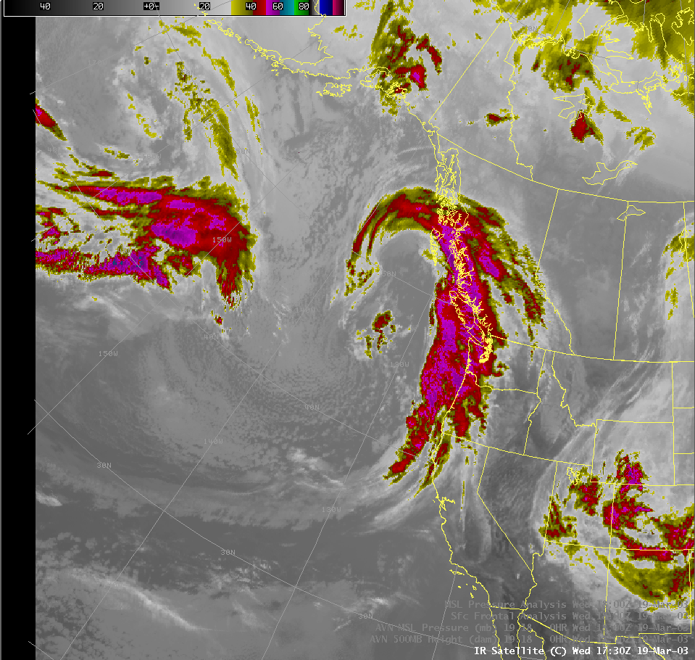
Example: Infrared Satellite Imagery

Slide 50
Interpreting Satellite Imagery
Types of Imagery
Water Vapor – A different type of infrared image
    Shows water vapor in the atmosphere
    Better at depicting the shape of troughs and ridges
    Usually color enhanced to show areas of greater moisture

Slide 51
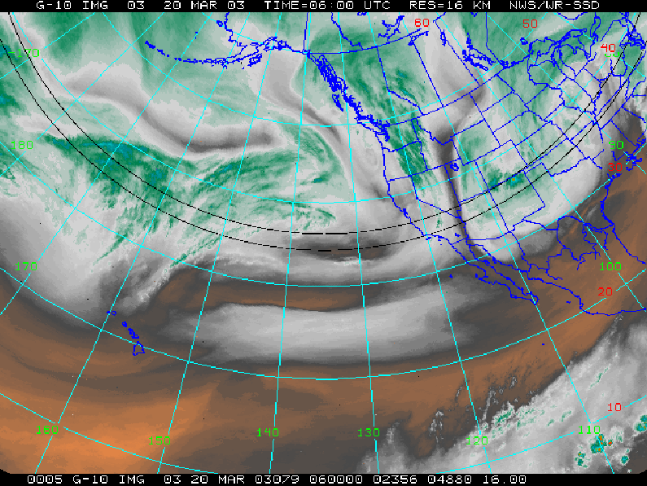
Example: Water Vapor Enhancement

Slide 52
Interpreting Satellite Imagery
Types of Imagery
Fog Product – A different type of infrared image
  A clever combination of two different IR channels
  Shows warm-topped clouds at or near the surface
  Good for spotting fog/stratus at night

Slide 53
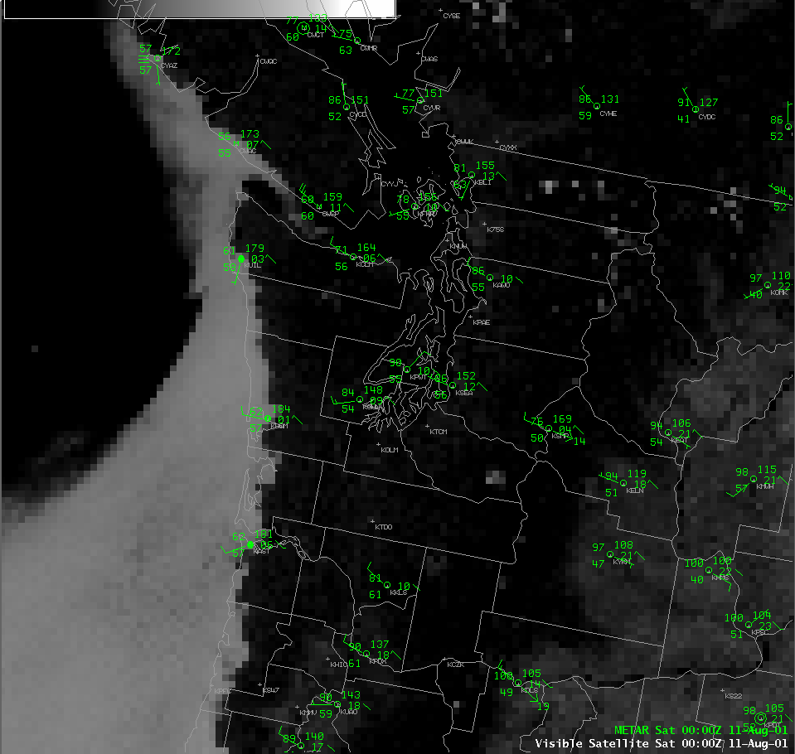
Visible Image of Stratus Along Coast

Slide 54
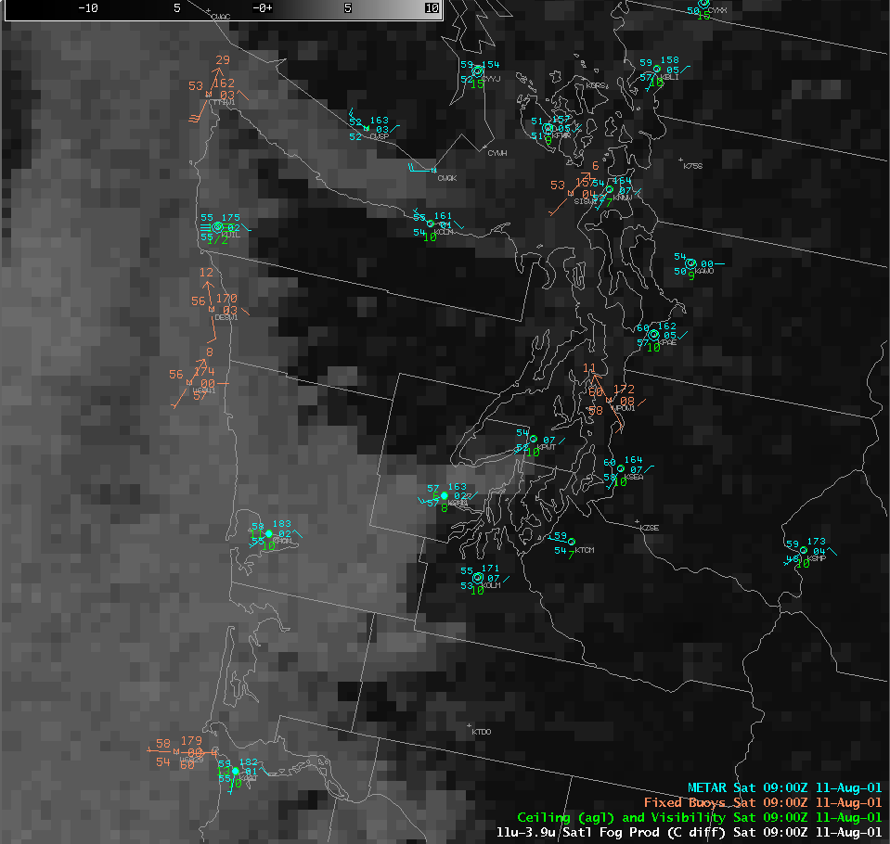
Fog Product of Inland Stratus

Slide 55
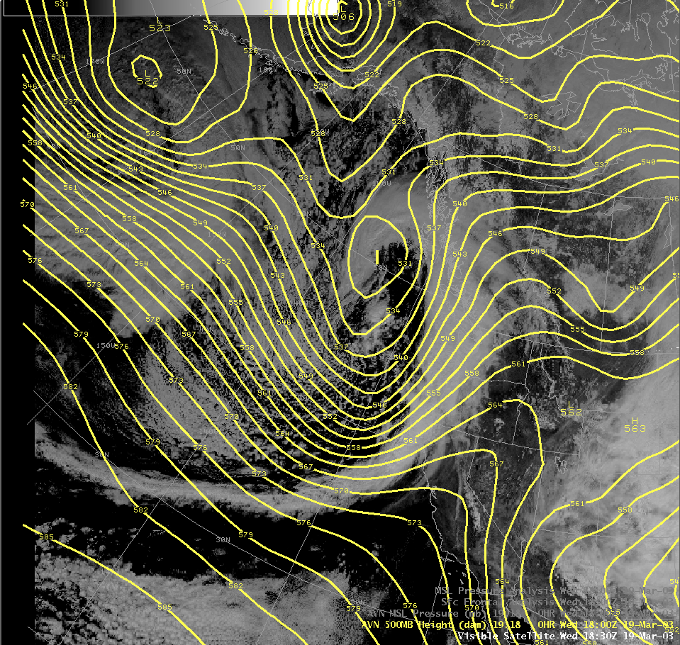
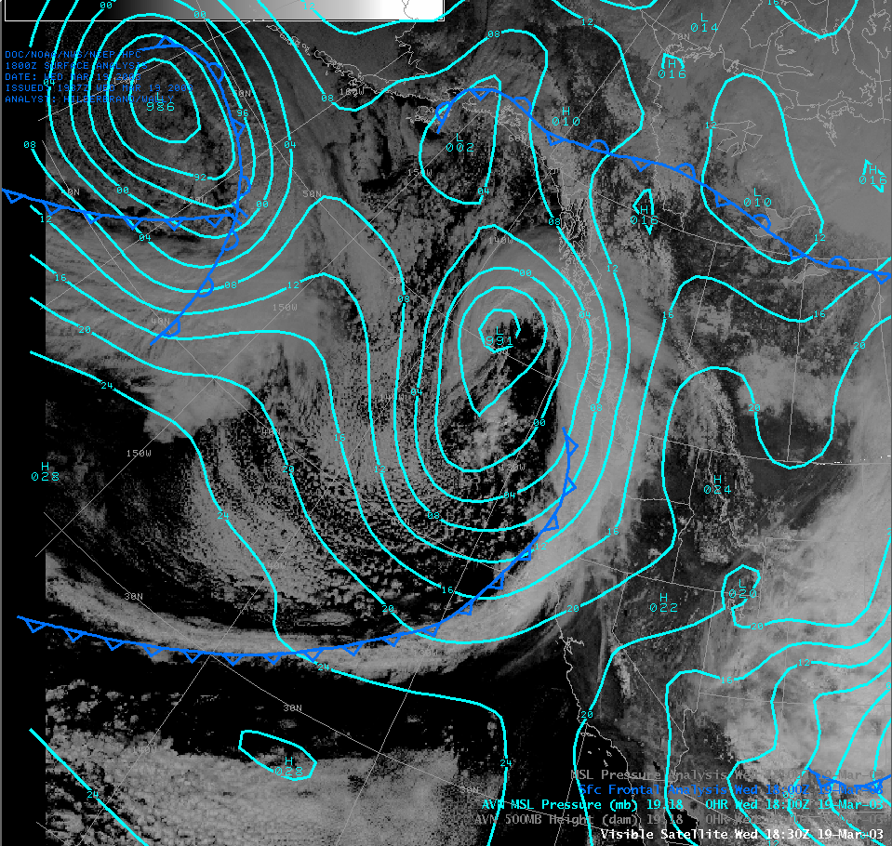
Combining Charts and Satellite Imagery

Slide 56
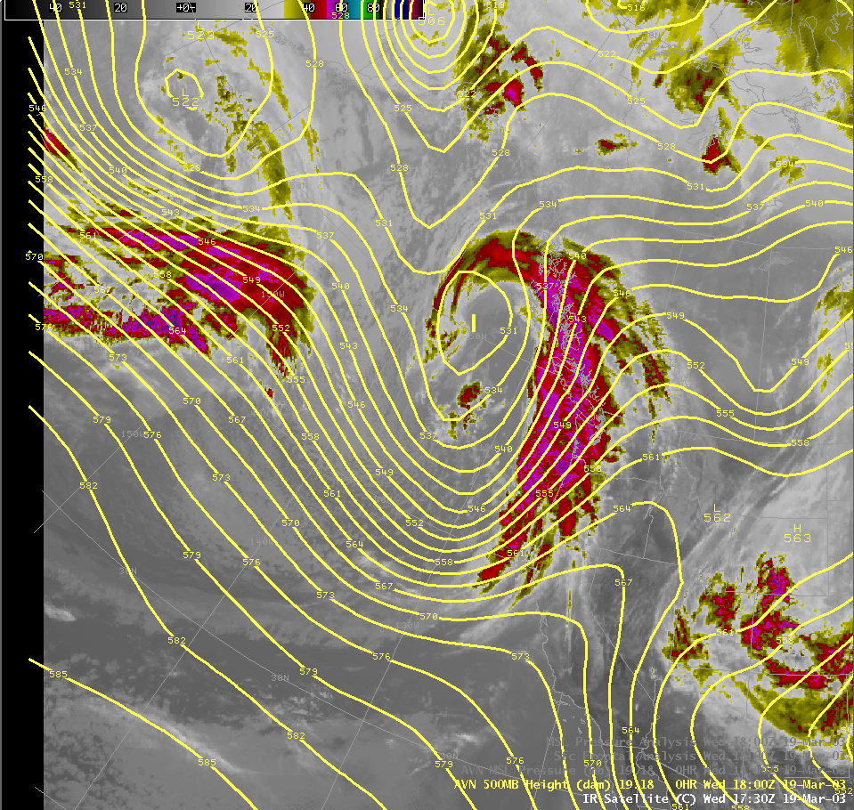
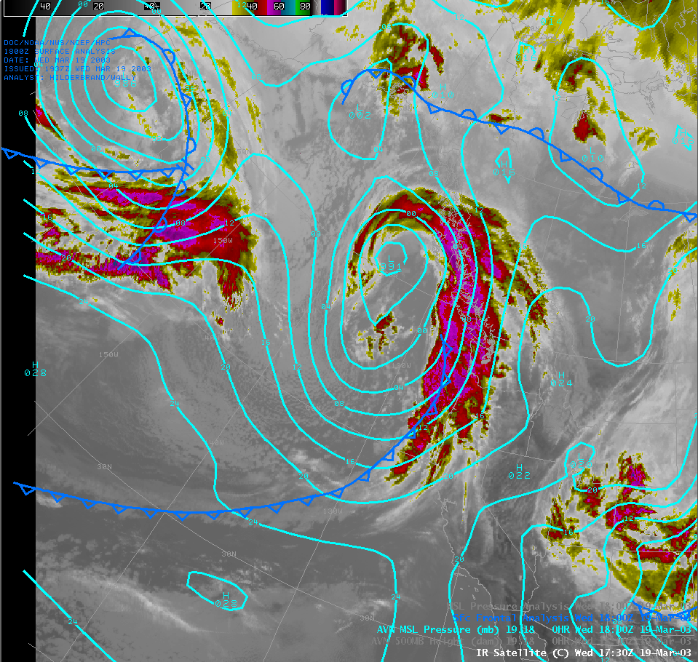
Combining Charts and Satellite Imagery

Slide 57
Comparing Visible and IR
Imagery Can Help You
Identify Significant Features
Introduction

Slide 58
Unstable Air = Post-Frontal Showers

Slide 59
Area of convection ahead of upper trough axis…possibly a thunderstorm

Slide 60
Conclusion
Seattle Center Weather Service Unit Operations
Area Forecast Discussion/Aviation Weather Discussion
Identifying Types of Weather Charts
Interpreting Constant Pressure Charts
Satellite Interpretation Relative to Charts

Slide 61
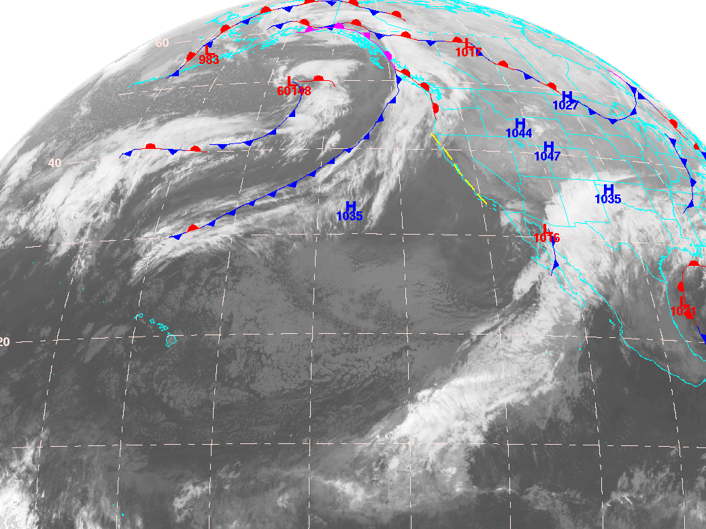
Questions?
Source: NWS/NCEP

