Slide 1
Graphics Generator Webinar #1
AHPS Products
Hank Herr

Slide 2
Outline
Objective of Webinars: Assist RFCs in moving off of ESPADP
FogBugz 1606: Changes to AHPS templates
Including HS Ensembles
Including Thresholds
Adding a Rating Curve Axis
Creating a Workflow
Tabular Output
Questions?
Notes:
The Editor interface provides several advantages, including shielding the user from XML formatting rules; providing immediate, graphical feedback after changes are made; and identifying errors in the PI-service configuration or parameters of the template. The only time the XML file should be manually edited, in my opinion, is if there is a change to make to many product templates so that its easier to open in a text editor and do a find-replace.

Slide 3
GraphGen Editor vs. XML
This webinar makes use of the GraphGen Editor Panel
Products and settings XML will not be edited during this presentation
Why? What are the advantages of the Editor?
The XML was never designed to edited by hand
Templates and settings were originally going to be stored invisibly within the CHPS database
No schema has been delivered
The Editor removes the possibility of bad XML configuration
The Editor provides immediate feedback for any changes made
XML editing requires that templates and settings be reloaded/refreshed with every change
The Editor makes it easy to spot when and where problems occur
Tabs indicate if errors are found
Error messages are displayed in the right-hand panels and Logs Panel
Other features allow for readily identifying issues with thresholds, rating curves, etc.
When is it reasonable to edit the XML by hand?
If you create a new product that appears much like an existing product, it may be easier to create it through manually editing the XML
Hank’s Opinion: I would still use the Editor and think about creating referenced templates
If you need to make a change to many templates at one time that can be done through a simple find-replace in the XML

Slide 4
FogBugz 1606
FogBugz 1606 includes changes to the AHPS templates to be delivered with CHPS 5.1.1
Fixed the legend title for the spaghetti plots
Ensured that all volume AHPS aggregations are preceded by a 24-hour daily mean computation
Fix will result in a slight change in computed volumes whenever the flow recorded at T0 is not included in the ESP ensemble
You should either import the new templates delivered with the next release or implement the changes yourself
See the FogBugz for instructions on making the change yourself

Slide 5
Include HS Ensembles (Applies only to the *ProbPlot Templates)
Create a historical time series and store in the localDataStore so that it will not expire
Setup module to sample an “HS” ensemble at forecast time
Graphics Generator Reference Manual, Section 2.9.1
Employ a sample-historical transformation
Run within a workflow as needed with a forecast length that matches that of the standard ESP forecasts
<transformation id="SampleESP_CNUO2">
<sample>
<historical>
<inputVariable>
<variableId>CNUO2_Historic</variableId>
</inputVariable>
<moduleParameterFile>SampleESP_Historical</moduleParameterFile>
<outputVariable>
<variableId>CNUO2_HS</variableId>
</outputVariable>
</historical>
</sample>
</transformation>

Slide 6
Include HS Ensembles (Applies only to the *ProbPlot Templates)
Update HS queries in the file …/PiServiceConfigFiles/GraphGen.xml
“QINE HS” and “SSTG HS” are provided but must be updated
ModuleInstanceSets.xml
GraphGen.xml
<moduleInstanceSet id="ALL_HS_TS">
<moduleInstanceId>ARCFUL_SampleESP_Historical</moduleInstanceId>
<moduleInstanceId>COLORADO_SampleESP_Historical</moduleInstanceId>
<moduleInstanceId>DENINF_SampleESP_Historical</moduleInstanceId>
<moduleInstanceId>EUFINF_SampleESP_Historical</moduleInstanceId>
...
<timeSeries>
<id>QINE HS</id>
<timeSeriesSet>
<moduleInstanceSetId>ALL_HS_TS</moduleInstanceSetId>
<valueType>scalar</valueType>
<parameterId>QINE</parameterId>
<locationSetId>ImportIHFSDB</locationSetId>
<timeSeriesType>simulated forecasting</timeSeriesType>
<timeStep unit="hour" multiplier="6" timeZone="GMT-0" />
<readWriteMode>read only</readWriteMode>
<ensembleId>HS</ensembleId>
<ensembleMemberIndexRange start="1951" />
</timeSeriesSet>
</timeSeries>
REMEMBER: Every element within the timeSeriesSet must be specified and must match the definition of the time series provided in the module that created it with appropriate ensemble information

Slide 7
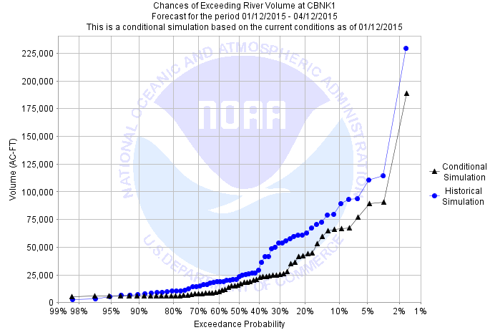
Include HS Ensembles (Applies only to the *ProbPlot Templates)
AHPS*ProbPlot images will pickup the change automatically

Slide 8
Including Thresholds
Thresholds are defined in ThresholdValueSets.xml
They are associated with time series in the database
If thresholds are defined in units that do not match the time series, then a rating curve must be included
<thresholdValueSet id="CBNK1" name="Corbin">
<unit>FT</unit>
<levelThresholdValue>
<levelThresholdId>BF</levelThresholdId>
<value> 8.00</value>
</levelThresholdValue>
…
<levelThresholdValue>
<levelThresholdId>RECORD</levelThresholdId>
<value> 22.74</value>
</levelThresholdValue>
<timeSeriesSet>
<moduleInstanceId>ImportIHFSDB</moduleInstanceId>
<valueType>scalar</valueType>
<parameterId>STG</parameterId>
<locationId>CBNK1</locationId>
<timeSeriesType>external historical</timeSeriesType>
<timeStep unit="nonequidistant"/>
<relativeViewPeriod unit="hour" start="-120" end="0"/>
<readWriteMode>read only</readWriteMode>
</timeSeriesSet>
…
</thresholdValueSet>
threshold id
associated time series

Slide 9
Including Thresholds
Thresholds are handed off to GraphGen via PI-timeseries XML
PI-service automatically provides thresholds with data if they are found
PI-timeseries XML/FI files must include it to be used by GraphGen
<?xml version="1.0" encoding="UTF-8"?>
<TimeSeries xmlns="http://www.wldelft.nl/fews/PI" xmlns:xsi="http://www.w3.org/2001/XMLSchema-instance" xsi:schemaLocation="http://www.wldelft.nl/fews/PI http://fews.wldelft.nl/schemas/version1.0/pi-schemas/pi_timeseries.xsd" version="1.7">
<timeZone>0.0</timeZone>
<series>
<header>
<type>instantaneous</type>
<locationId>CBNK1</locationId>
<parameterId>QINE</parameterId>
…
<units>CMS</units>
<thresholds>
<highLevelThreshold id="BF" name="Action stage" value="76.663536"></highLevelThreshold>
<highLevelThreshold id="FS" name="Flood stage" value="135.54494"></highLevelThreshold>
<highLevelThreshold id="MOD" name="Moderate Flood stage" value="654.135"></highLevelThreshold>
<highLevelThreshold id="MAJOR" name="Major Flood Stage" value="2095.1926"></highLevelThreshold>
<highLevelThreshold id="RECORD" name="Record Flood Stage" value="1005.1724"></highLevelThreshold>
</thresholds>
</header>
</series>
</TimeSeries>

Slide 10
Including Thresholds
GraphGen Editor allows for editing the default provided thresholds for display in a product
Thresholds are recorded for those input series for which the Include Thresholds Checkbox is checked in the Input Series Panel
Available default thresholds are listed in the Default Thresholds Table of the Thresholds Editing Panel in the Appearance Panel

Slide 11
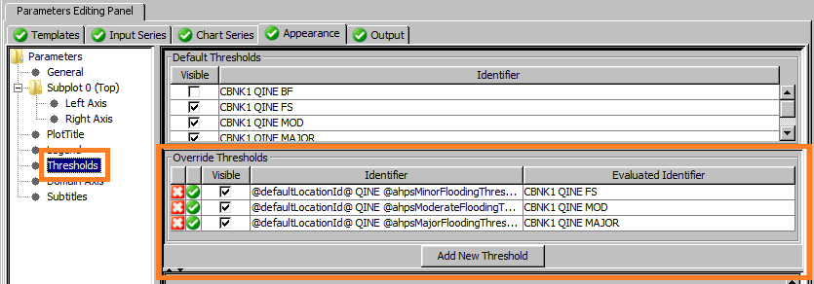
Including Thresholds
Changes are made to an override threshold listed in the Override Thresholds Table
An override threshold is not created until either a threshold is made visible by clicking on the checkbox in the Default Thresholds Table –or– by clicking on the Add New Threshold Button and specifying an id that evaluates to the same id as the default

Slide 12
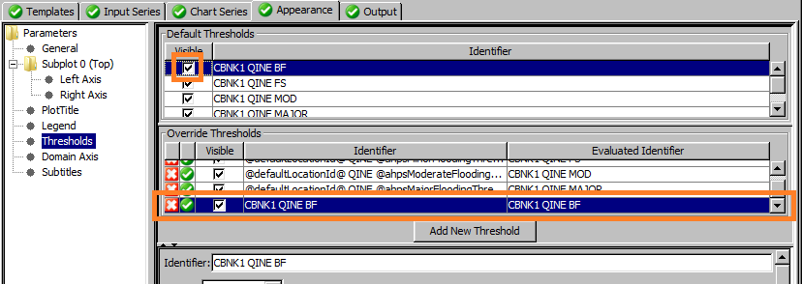
Including Thresholds
If a threshold is made visible through clicking on the visible checkbox in the Default Thesholds Table, then the created threshold will by default have the same ‘Identifier’ as that default threshold
The ‘Evaluated Identifier’ is the identifier with all arguments replaced by their values

Slide 13
Including Thresholds
Making that identifier generic using arguments is critical to allowing the product template to be applicable to multiple segments
The ‘Evaluated Identifier’, which displays the identifier after evaluating all arguments, must match the identifier of the default threshold that corresponds to it
The standard AHPS product thresholds are an example of this:
Identifier now uses arguments:
defaultLocationId – a predefined argument set equal to the active segment id, by default
ahps*FloodingThresholdId – three arguments defined during the product installation process

Slide 14
Including Thresholds
If the default threshold is not found for an override that expects it, that override is invalid, which will be marked by a icon…
… and appropriate warning messages will be displayed in the Logs Panel
If it is correct that the location does not include thresholds, then the invalid thresholds and warning messages can be ignored
Otherwise, there is a configuration error
Question: Should the messages be INFO level instead?

Slide 15
Including Thresholds
GraphGen automatically assigns the start value for a threshold to the threshold value itself
AHPS products then define the end value to match that of the next threshold (minor uses moderate as its end, moderate uses major, and major is unbounded) through the use of arguments
For the minor threshold, the starting value is identical to that acquired from the time series
Ending value uses arguments to refer to the moderate threshold
(if a referenced threshold does not exist, the end value is made ‘unbounded’)
Ending value for the major threshold is unbounded

Slide 16
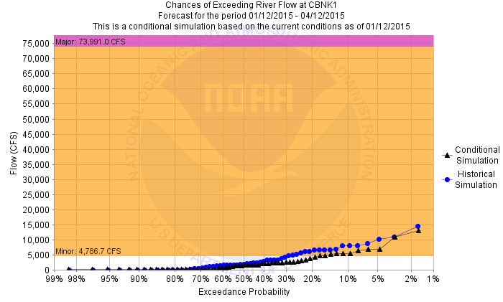
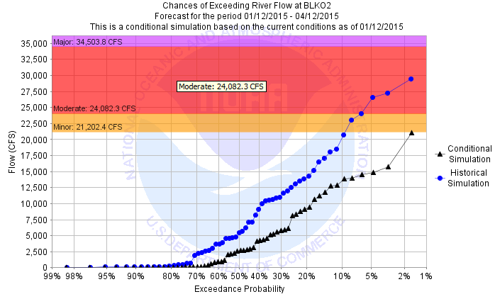
Including Thresholds
The valid ( )thresholds will display correctly even when one or more other thresholds are invalid
Exception: When the moderate threshold is invalid and the thresholds are displayed as zones, as with AHPS*ProbPlot (though it may be hard to tell)
Color doesn’t match (minor threshold is unbounded)

Slide 17
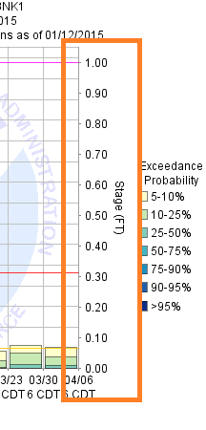
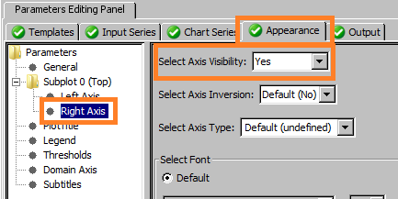
Adding a Rating Curve Axis
Rating curves are applied through the FEWS PI-service
PI-service connection must be properly defined
To create a rating curve axis, the axis must first be made visible
Click on Appearance Tab
Select the axis (left or right)
Select the axis visibility
Axis will be a linear [0, 1] axis by default
For histogram products, axis is pre-labeled
1
3
2
Notes:
If you want to add a rating curve axis to the AHPS products, check with your regional representative.

Slide 18
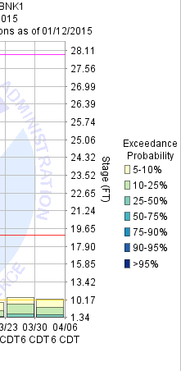
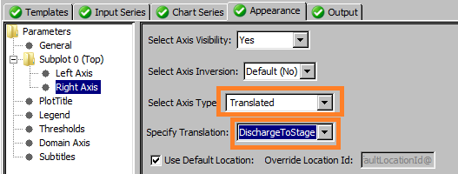
Adding a Rating Curve Axis
To make the axis a rating curve axis:
Set the axis type to be ‘Translated’
Select a translation to be either ‘StageToDischarge’ or ‘DischargeToStage’ depending on the opposite axis
1
2
Default location id is ‘@defaultLocationId@’
(i.e., the active segment id, unless overridden by user)

Slide 19
Adding a Rating Curve Axis
Location id must match the locationId used to define the rating curve that is applied
Rating curves can be imported or defined within …/Config/RegionConfigFiles/RatingCurves.xml
Example RatingCurves.xml (ex. from CNRFC)
<RatingCurves xmlns="http://www.wldelft.nl/fews/PI" xmlns:xsi="http://www.w3.org/2001/XMLSchema-instance" xsi:schemaLocation="http://www.wldelft.nl/fews/PI http://chps1/schemas/pi-schemas/pi_ratingcurves.xsd">
<timeZone>0.0</timeZone>
<!-- Ratings added for forecast group NorthCoast -->
<ratingCurve>
<header>
<locationId>ARCC1</locationId>
<startDate date="1900-01-01" time="00:00:00"/>
<stationName>MAD - ARCATA, NR</stationName>
<stageUnit>FT</stageUnit>
<dischargeUnit>CFS</dischargeUnit>
</header>
<table>
…

Slide 20
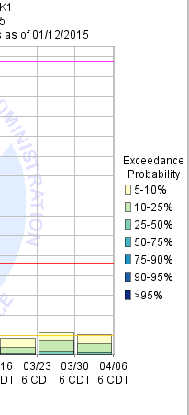
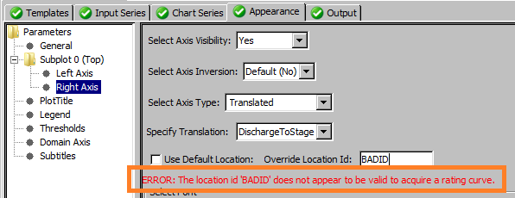
Adding a Rating Curve Axis
If location id does not correspond to a rating curve, an error will be displayed below the Use Default Location Checkbox and the axis will not be visible (but product will still build)
An appropriate warning message will also be displayed in the Logs Panel
Axis is not displayed
Bad id is used
TIP: If you use 5-character ids for rating curves, you may want to use ‘@handbook5id@’ as the location id, particularly if your segment ids may be more than 5-characters

Slide 21
Creating a Workflow
Products can be generated via a GeneralAdapter execution
Standard module configuration file must be specified with only the following activities:
exportRunFileActivity: Specifies PI-service connection, products and settings file to use, and product templates to process
executeActivity: Specifies the appropriate className and appropriate binDir
<?xml version="1.0" encoding="UTF-8"?>
<generalAdapterRun xmlns=…>
<general>
….
</general>
<activities>
<exportActivities>
<exportRunFileActivity>
<exportFile>%ROOT_DIR%/run_info.xml</exportFile>
<properties>
…
</properties>
</exportRunFileActivity>
</exportActivities>
<executeActivities>
<executeActivity>
…
</executeActivity>
</executeActivities>
</activities>
</generalAdapterRun>
Class name must always be set to: ohd.hseb.graphgen.adapter.GraphGenModelAdapter

Slide 22
Creating a Workflow
PI-service connect is specified through run file properties
To execute the workflow within a interactive session of CHPS, just specify the port number (or leave blank to use the default 8100 port):
To use a back-end PI-service, perhaps running the adapter through a scheduled workflow, the complete URL must be specified via three properties:
<string key="piServicePortNumber" value=“8101" />
Example URL: https://localHost:2008/abrfc_pi/FewsPiService
<string key="piServicePortNumber" value=“2008“/>
<string key="piServiceHostName" value=“localHost"/>
<string key="piServiceBackendRFCIdentifier" value=“abrfc_pi"/>

Slide 23
Creating a Workflow
Product templates to process (and generate output files) is specified through run file properties
Currently, one property is required for each segment for which product templates are to be processed and products generated
May require hundreds of properties to be defined
Key is of the form products.<segment id>
Value consists of template ids and/or Java patterns separated by ;
<string key="products.AERK1" value="AHPS[a-zA-Z]*" />
<string key="products.AGAK1" value="AHPS[a-zA-Z]*" />
<string key="products.AGSK1" value="AHPS[a-zA-Z]*" />
<string key="products.ALBK1" value="AHPS[a-zA-Z]*" />
<string key="products.ALMK1" value="AHPS[a-zA-Z]*" />
<string key="products.ALXO2" value="AHPS[a-zA-Z]*" />
<string key="products.AMAT2" value="AHPS[a-zA-Z]*" />
<string key="products.AMCK1" value="AHPS[a-zA-Z]*" />
…
Java patterns are described here:
http://docs.oracle.com/javase/7/docs/api/java/util/regex/Pattern.html

Slide 24
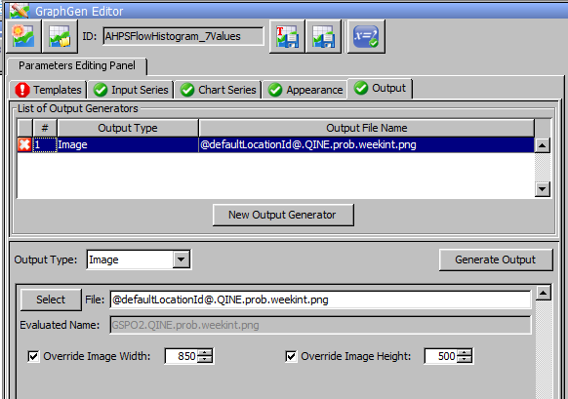
Creating a Workflow
Output files are generated based on the output generators defined for the product templates
See the Outputs Panel of the GraphGen Editor Panel
Files are placed under the directory defined by run file property baseOutputDir

Slide 25
Creating a Workflow
FB 1619: Enhancement in next CHPS release (OHD-CORE-CHPS 4.2.a) will allow for specify products through a PI-service query
Query is specified via a getSegmentsFromQuery property:
Value specifies a file within …/Config/PiServiceConfigFiles (.xml optional; referred to as clientId in the GraphGen Editor Panel) and the id of the query to perform
Products are specified through a products property with no suffix
What does it do?
Query is executed and locationIds are extracted from the time series headers acquired (data is not acquired)
Those locationIds are assumed to correspond to segment ids and, therefore, defaultLocationId arguments
Results will incorporate id-mappings, so in most cases locations will correspond to segment ids
If you have defined location sets that correspond to the segments for which to generate products (after id-mapping is applied), then you can define all of the product templates to process using only these two properties
<string key="getSegmentsFromQuery" value="GraphGen; QINE"/>
<string key="products " value="AHPS[a-zA-Z]*" />

Slide 26
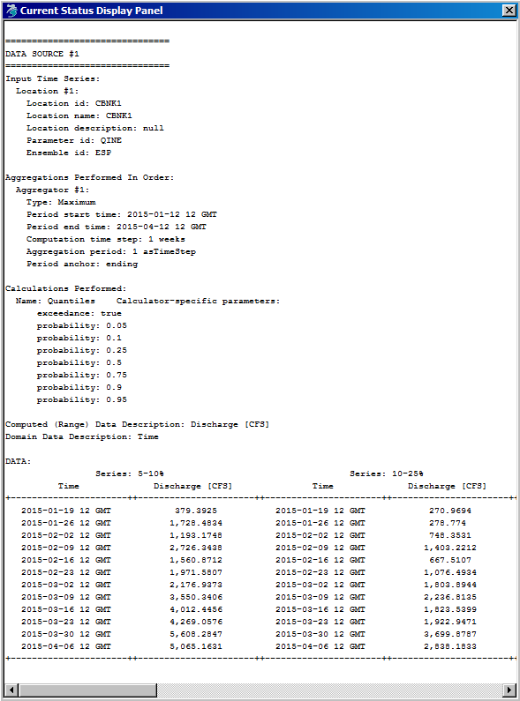
Tabular Output
Tabular output is controlled by template parameters
One “Data Source” per chart series
Includes referenced templates
Input time series info
Determined from used data – Input Series Panel and Selected TS Panel
Parameters of aggregators
Aggregators Panel
Parameters of calculator
Calculator Panel
Range data description
Determined from data and calculation
Domain data description
Determined from data and calculation
Series legend entry
Series Drawing Parameters Table
Notes:
In response to a user request for information on the “configuration/setting of the Tabular Output”.

Slide 27
Questions?
Topic of GraphGen Webinar #2:
LRO product

Slide 28
Appendix

Slide 29
Outline
Using ID-Mapping in PI-service Config Files
Importing and Moving Templates
Creating Templates for Other Data Types

Slide 30
Using ID-Mapping in PI-service Config Files
Graphics Generator products typically use the active segment id as the pi-timeseries locationId for identifying time series data
‘@defaultLocationId@’ – set to the active segment id by default
Implies two constraints:
All time series referred to in product templates have identical locationId
That locationId equals the active segment id
If the locationId to use is not the active segment id, then what do you do?
If the locationId satisfies constraint 1 (always the same), then you can override the defaultLocationId argument via the Modify Settings Dialog
If the locationId can vary, then it is best to use an id-mapping
In some cases, even an id-mapping is not sufficient and specialized products must be created. Example: MEFP products use mefpCatchmentId#, because segments can include multiple catchments.

Slide 31
Using ID-Mapping in PI-service Config Files
CBRFC Example
The file contains over 1300 lines!
Size will vary by RFC: ABRFC’s contains only 49 lines
Unfortunately, GraphGen needs to know what locationId to use, and the only id available to it is the active segment id
FEWS cannot figure out what time series you want based on a partially matching locationId
<?xml version="1.0" encoding="UTF-8"?>
<idMap xmlns="http://www.wldelft.nl/fews" xmlns:xsi="http://www.w3.org/2001/XMLSchema-instance" version="1.1" xsi:schemaLocation="http://www.wldelft.nl/fews http://chps1/schemas/idMap.xsd">
<!--Id Maps for WHYAM-->
<location external="FISC2H_F" internal="FISC2"/>
<location external="YASC2H_F" internal="YASC2"/>
<location external="SCHC2R_F" internal="SCHC2"/>
<location external="YMSC2O_F" internal="YMSC2"/>
<location external="STMC2L_F" internal="STMC2"/>
<location external="ENMC2H_F" internal="ENMC2"/>
<location external="ELHC2H_F" internal="ELHC2"/>
<location external="ELCC2O_F" internal="ELCC2"/>
…

Slide 32
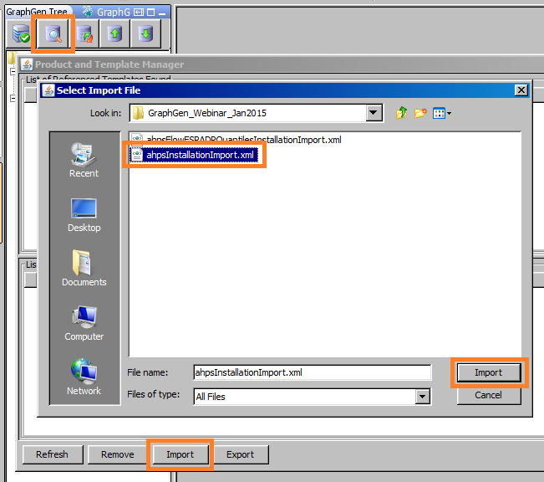
Importing and Moving Templates
1
Click on the Manage Products Button
Click on the Import Button
Select the file and click Import
List of templates in Product and Template Manager Dialog will change and the GraphGen Tree Panel will update
3
4
2

Slide 33
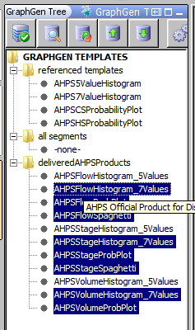
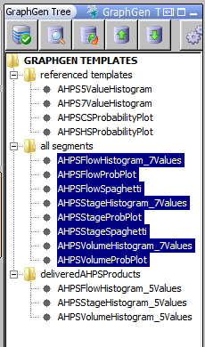
Importing and Moving Templates
After setting up arguments and confirming that the products can be viewed, do the following:
Determine if *_5Values or *_7Values histograms will be used
Move the chosen histogram product templates to “all segments” by clicking (use shift/ctrl to select multiple templates) and dragging in the GraphGen Tree Panel
After selecting the last product, depress the shift/ctrl key and move the mouse over “all segments” before releasing the mouse button.

Slide 34
Creating Templates for Other Data Types
The following outlines the steps of an example of creating an AHPS product for a different data type
Example used: PELE – Reservoir Pool Elevation(Simulated)
Create a query that yields an ensemble of that type
Example: Added to GraphGen.xml
<timeSeries> <!– PELE (pool elev.) ESP forecast -->
<id>PELE ESP</id>
<timeSeriesSet>
<moduleInstanceSetId>All_Reservoir_Cnav_Forecast</moduleInstanceSetId>
<valueType>scalar</valueType>
<parameterId>PELE</parameterId>
<locationSetId>Reservoirs</locationSetId>
<timeSeriesType>simulated forecasting</timeSeriesType>
<timeStep unit="hour" multiplier="6"/>
<readWriteMode>add originals</readWriteMode>
<ensembleId>ESP</ensembleId>
<ensembleMemberIndexRange start="1951" />
</timeSeriesSet>
</timeSeries>
Note the query id

Slide 35
Creating Templates for Other Data Types
If a threshold is to be displayed, create a query that yields a time series that includes those thresholds
GraphGen.xml Query
<timeSeries> <!-- for thresholds: Single-valued PELV obs -->
<id>PELV</id>
<timeSeriesSet>
<moduleInstanceId>ImportIHFSDB</moduleInstanceId>
<valueType>scalar</valueType>
<parameterId>PELV</parameterId>
<locationSetId>Reservoirs</locationSetId>
<timeSeriesType>external historical</timeSeriesType>
<timeStep unit="hour" multiplier="6" />
<readWriteMode>read only</readWriteMode>
</timeSeriesSet>
</timeSeries>
ThresholdValueSets.xml Entry
<thresholdValueSet id="GSPO2" name="Jet">
<unit>FT</unit>
<levelThresholdValue>
<levelThresholdId>MODPOOL</levelThresholdId>
<value>1133.5</value>
</levelThresholdValue>
<levelThresholdValue>
<levelThresholdId>MAXPOOL</levelThresholdId>
<value>1138.50</value>
</levelThresholdValue>
<timeSeriesSet>
<moduleInstanceId>ImportIHFSDB</moduleInstanceId>
<valueType>scalar</valueType>
<parameterId>PELV</parameterId>
<locationId>GSPO2</locationId>
<timeSeriesType>external historical</timeSeriesType>
<timeStep unit="hour" multiplier="6"/>
<relativeViewPeriod unit="hour" start="-120" end="0" endOverrulable="true"/>
<readWriteMode>add originals</readWriteMode>
</timeSeriesSet>

Slide 36
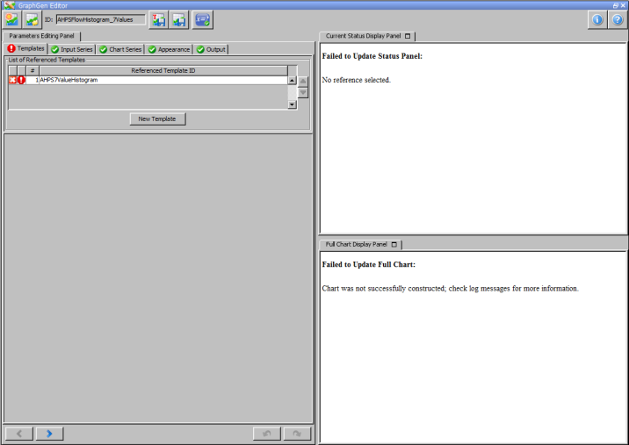
Creating Templates for Other Data Types
Select an existing AHPS product template to serve as a starting point
Example: AHPSFlowHistogram_7Values
Select an example segment in the Forecasts Panel
Example: GSPO2
Open the selected template in the GraphGen Editor Panel
Save it immediately with a new product template id that is appropriate
Example: AHPSPoolElevHistogram_7Values
In some cases, the start point product template may not display properly depending on data available at example segment

Slide 37
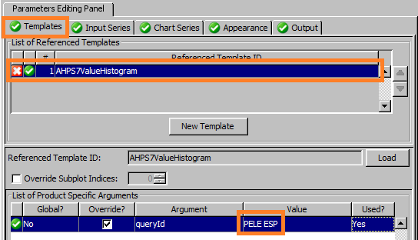
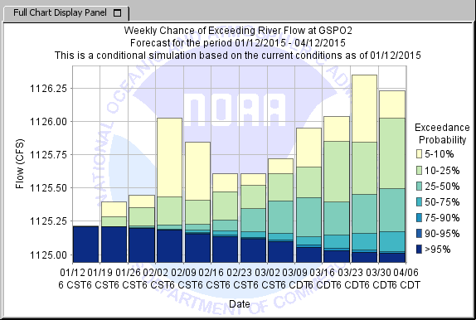
Creating Templates for Other Data Types
If a referenced template is used, modify its arguments so that the appropriate query is called
Example: Referenced template should use query ‘PELE ESP’
1
Chart is drawn, but no thresholds are displayed
2
3
For some starting-point products, there may not be a referenced template to change. In that case, changes will need to be made to input series providers (next slide).

Slide 38
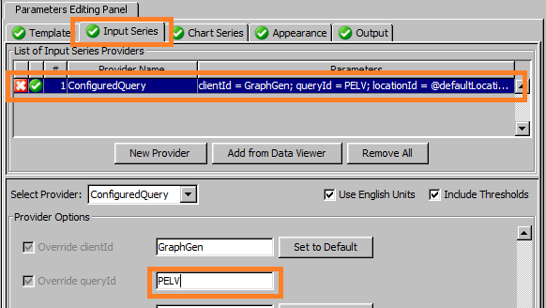
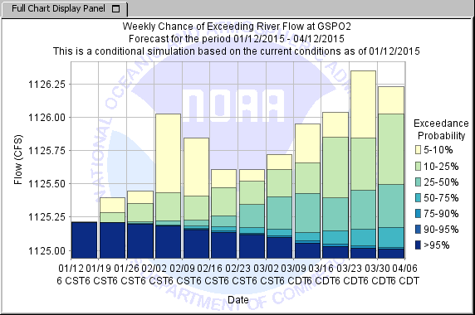
Creating Templates for Other Data Types
Modify input series providers appropriately
Example: Input series provider in this case is only used to acquire thresholds, and should therefore call query ‘PELV’
1
Still no thresholds
2
3
If the chart does not display at this point, then there must be a configuration issue/error or the segment id does not match the locationId of the time series acquired via the PI-service (check the id-mapping and change if necessary).

Slide 39
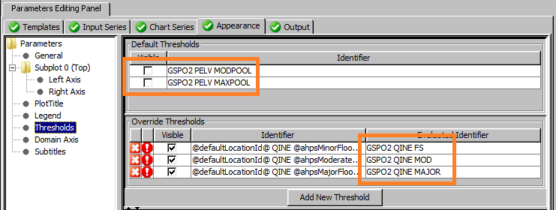
Creating Templates for Other Data Types
If thresholds are expected to be displayed, but are not, check the Appearance Panel
See previous slides on thresholds and change identifiers as needed…
Example: Threshold ids are MODPOOL and MAXPOOL, which do not match those expected in the starting point product
Also, the parameterId QINE must be changed to PELV

Slide 40
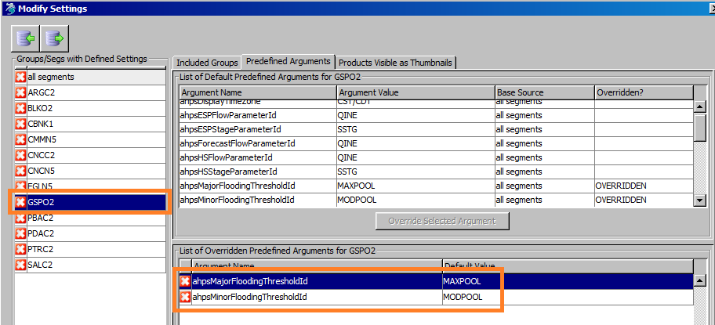
Creating Templates for Other Data Types
Open the Modify Settings Dialog and set the moderate and major thresholds for the segment appropriately
Example:
In the Editor, remove any unused threshold overrides
Example: Minor threshold is not defined, so remove it.

Slide 41
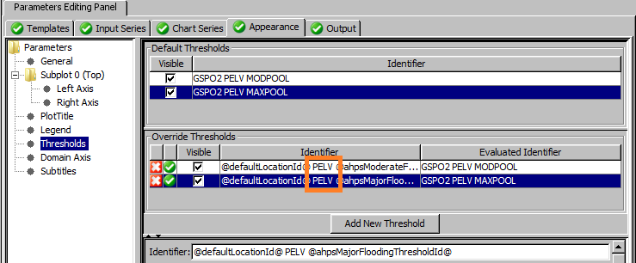
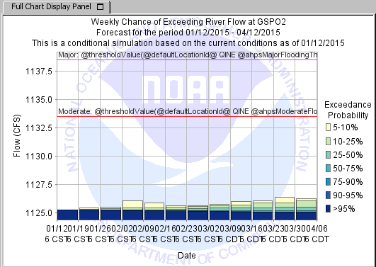
Creating Templates for Other Data Types
Change the remaining threshold identifiers appropriately
Example: Click on the row of the Override Thresholds Table and, when the Specify Identifier Dialog opens, change QINE to PELV
Thresholds are displayed, but label is incorrect

Slide 42
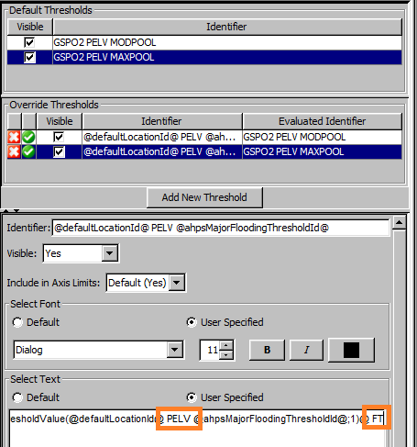
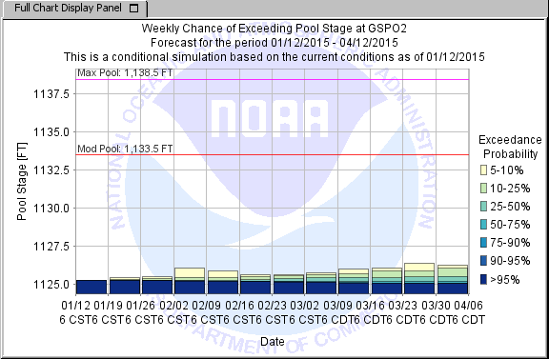
Creating Templates for Other Data Types
If the label for the threshold is not correct, modify it
Example: Threshold label should use ‘PELV’ in the thresholdValue argument function and the correct unit
Thresholds are displayed correctly

Slide 43
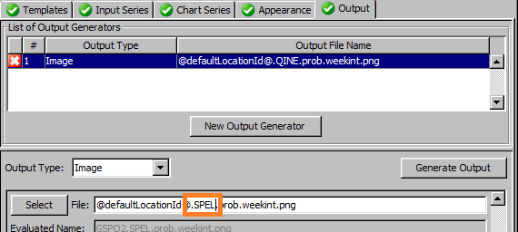
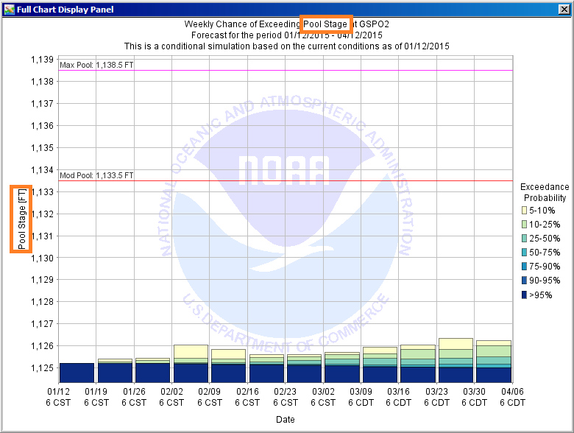
Creating Templates for Other Data Types
Make other changes as needed
Example: plot title, range axis, output generator file name
Default range axis is used

Slide 44
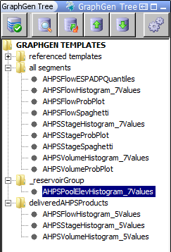
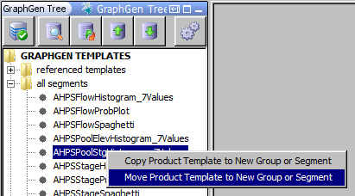
Creating Templates for Other Data Types
After making all needed changes, save the product template
If the product is to be displayed for only some segments, then use product group feature
Create an appropriate group
Example: _reservoirGroup
The group can be created by moving the product template to a group with that name within the GraphGen Tree Panel
Right-click pop-up menu

Slide 45
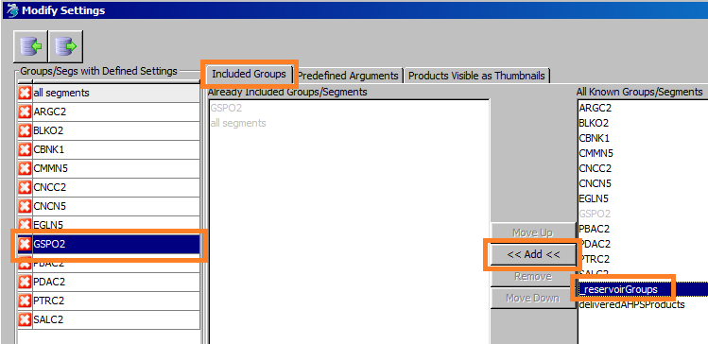
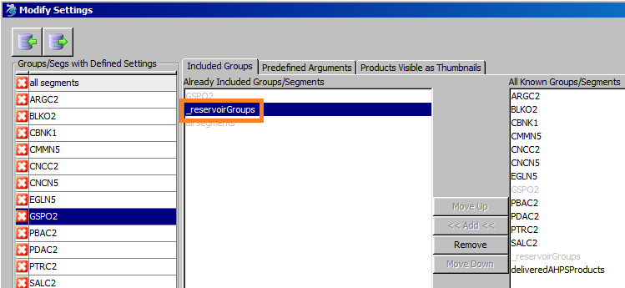
Creating Templates for Other Data Types
Include the group for all segments for which the product is to be produced using the Modify Settings Dialog
Example: GSPO2 is one such segment
2
The _reservoirGroup will move to the Already Included List
1
4
3

Slide 46
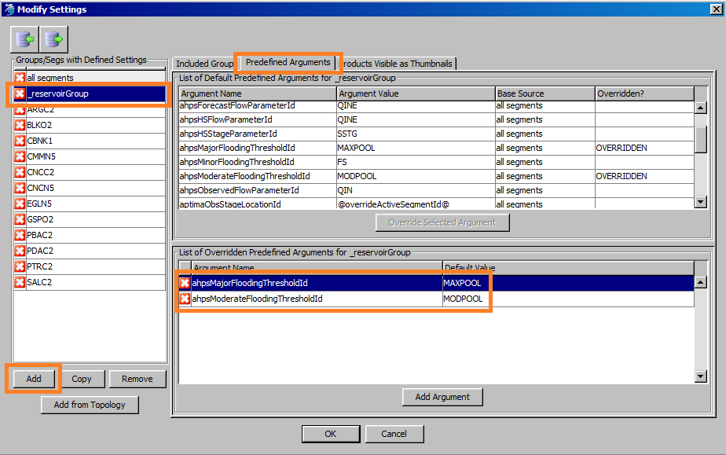
Creating Templates for Other Data Types
If appropriate, move overridden arguments to the created group
Example: The overrides for ahpsModerateFloodingThresholdId and ahpsMajorFloodingThresholdId can be defined in _reservoirGroup and removed from GSPO2, because all reservoir segments use those ids
3
2
Notice that the base source for ahpsMajorThresholdId is now _reservoirGroup
4
1
5
6

Slide 47
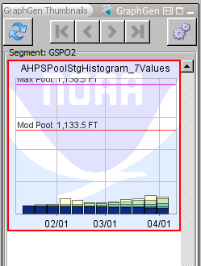
Creating Templates for Other Data Types
Product should now be visible as a thumbnail in the GraphGen Thumbnail Panel and ready to be generated via a workflow

